Slide 1
On the Impact and Defeat of Regular Expression Denial of Service Jamie Davis Final Defense

Slide 2
This page left intentionally blank

Slide 3
This page left intentionally blank

Slide 4
On the Impact and Defeat of Regular Expression Denial of Service Jamie Davis Final Defense
Notes:
Hello, everybody! I am glad to see all of you this morning, albeit virtually.
As Dr. Lee said, I’m here to DEFEND my PhD dissertation: On the Impact…
Thanks:
Committee
Dongyoon
CS@VT department
Family & Friends
Kirsten, who has been a delightful companion throughout this journey.
TRANSITION: This will be a long talk, so let me show you the general outline.

Slide 5


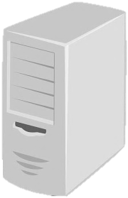


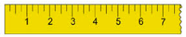

Talk Outline
Background
Impact
Defeat
/a+/
Thesis
ReDoS is a security threat to real-world software.
Existing solutions are ineffective or impractical.
Our new approaches appear promising.
Notes:
…This will be a long talk, so let me show you the general outline.
Three core parts.
I’ll wrap up by talking about implications and potential future work.
TRANSITION
Let's get started with the background material.

Slide 6
Background
Impact
Defeat
Talk Outline
/a+/
Regexes 101
Slow regex engines
Regex Denial of Service
State of the art
Notes:
...let's get started with the background material.
There are a few ingredients you'll need to understand:
- Review what a regex is,
- Talk about how regex engines work,
- Explain the ingredients for Regex DoS,
and
- Summarize the state of the art on Regex DoS research

Slide 7


Regexes 101
[M&P ‘43, K ‘51]
/a+/
Concept
Core operations
String language
~40% of SW projects
ab ab
a* a, aa, aaa, …
a | b a, b
[C&S ‘16]
Examples
\S+ @ \S+ \. \S+ ← Email
\d{1,3} \. \d{1,3} \. \d{1,3} \. \d{1,3} ← IPv4
^[a-zA-Z0-9]+ ( [._]? [a-zA-Z0-9]+ )* $ ← Username
Notes:
Regular expressions are a popular tool for string matching problems.
Let me tell you what you’ll need to know about them.
Conceptually, regexes are a means of encoding a
* regular language: some useful subset of all possible strings, like “strings that look like email addresses”
They are supported in all mainstream PLs, and are widely used in practice.
* By one estimate, about 40% of software projects use regexes in one way or another.
Practically, engineers encode regex string constraints using
* three core regex operations:
* Concatenation, * repetition, * disjunction
Most programming languages offer about 30 distinct regex operations
Let me show you a few examples:
* Here’s a regex that matches email addresses, taken from the popular Django web framework. You can see that it looks like a generalization of your own email address: “Your username, an @, and then the domain name”
* Here’s a regex for IPv4 addresses: 4 sets of 1-3 digits, separated by periods
* Here’s a regex for Windows usernames: it starts with a letter or a number, and then contains letters, numbers, underscores, and periods
TRANSITION
Next I’d like to share a diagram to help you understand the regex notation, and then I’ll show you how these regexes might be used in practice.
===
* Practitioners have extended regular expressions beyond automata 101.
Real-world regexes are expressive enough that you can encode NP-hard problems with them.
* But various researchers have showed that
* Although some regexes have linear worst-case match time,
* Other regexes will have polynomial
* Or even exponential worst-case match times as a function of the length of the input

Slide 8

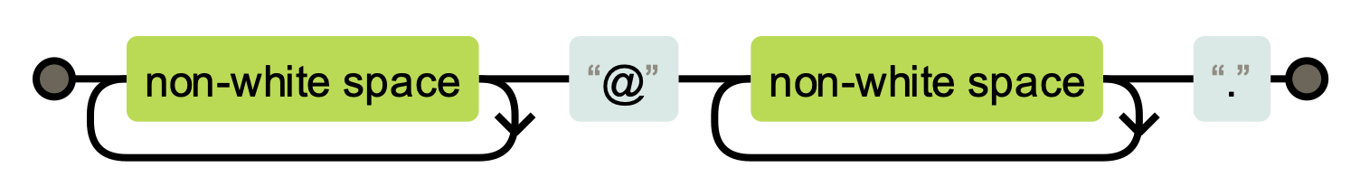
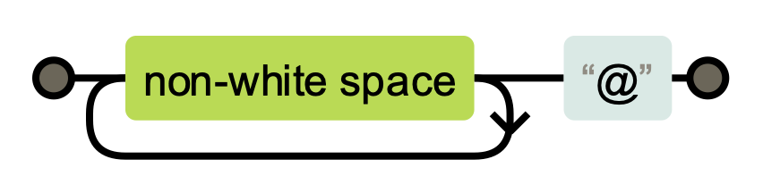
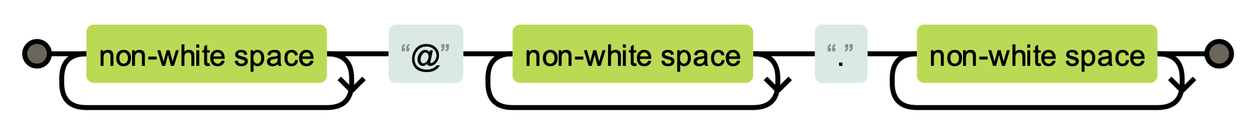
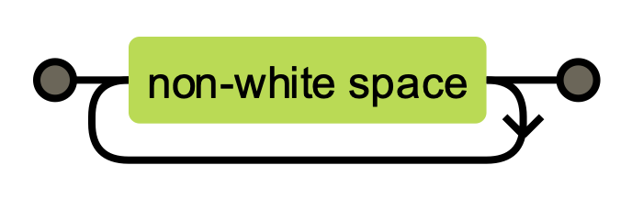
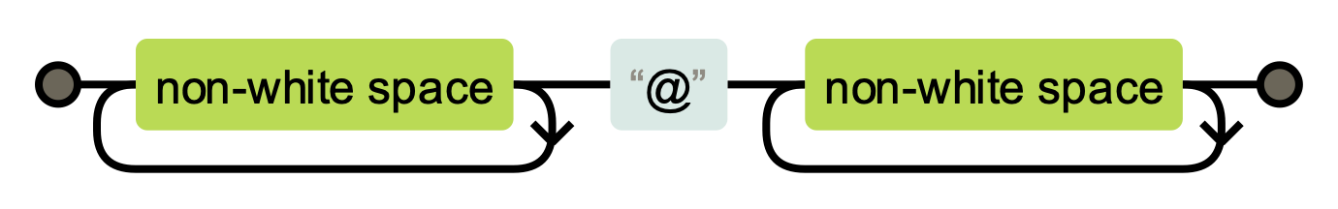
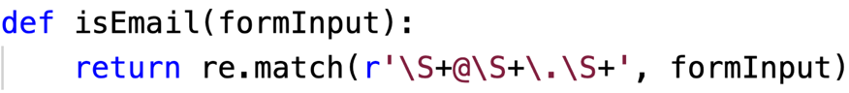
How software engineers use regexes: \S+ @ \S+ \. \S+
[C&S ‘16, M ‘19]
\S+
@
\S+
\.
\S+
davisjam
@
vt
.
edu
Notes:
(In the title) I said that this was a regex for emails.
To understand that, we can build up a diagram for each piece of the regex.
* The \S+ means “One or more non-whitespace characters”, which we can represent by a loop on this block.
* The “@” means ”a literal @ symbol”
* The next \S+ has the same meaning as the first one, and we can represent it the same way.
* Then a literal “period” character
* And finally one more loop of \S+
To test if a regex matches a string, you have to solve a maze: take your finger and try to find a path from the left side to the right side, while honoring all of the labels you encounter.
For example, we can match my email address…
According to surveys by Chapman, Michael, and Donohue, software engineers commonly use regexes to perform input validation.
Engineers use regexes as an early step when processing untrusted and unstructured text.
* If we peek at some server-side software running on the web,
* we might see here a function like this one:
it tests whether web form input is an email,
* using this regex.
TRANSITION
Software engineers don’t actually build these diagrams and use their fingers to handle Internet traffic.
They write regexes, and delegate the responsibility for checking matches to an entity known as a regex engine.

Slide 9


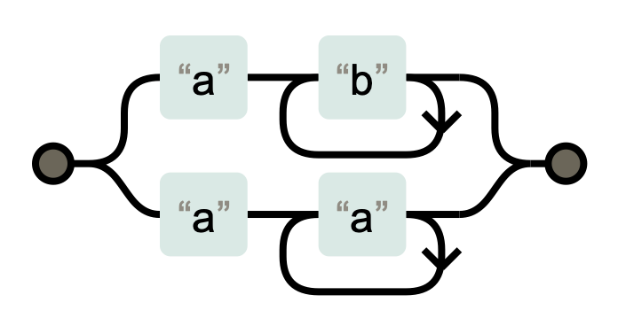



How most regex engines work
[S ’94]
What’s a regex engine?
match(regex, string) ← “Does this regex match this string?”
How do they work?
ab+ | aa+
Simulate on input
“aaa”
Depth-first backtracking search
Notes:
Every mainstream programming language offers engineers a regex engine to answer “match” queries.
* Most of them use the diagram-finger method to solve these queries.
* They take a regex pattern like this one,
* and convert it to an equivalent Non-deterministic Finite Automaton (or NFA).
These NFAs are just like the diagrams we’ve been looking at so far.
* The regex engine then simulates the NFA on the candidate string to see if it can find a match, just like we did with our finger.
* Here’s an example on the candidate string “aaa”
TRANSITION
* Most regex engines use what’s called a naive depth-first backtracking algorithm to search for a match.
In this algorithm, they move their finger along the diagram, and any time they come to a choice they write down all of the options, take the first one, and try the others later if the first option doesn’t work.
This approach is straightforward, but it introduces potentially problematic worst-case match performance – in other words, the regex engine may take a very long time to answer some match queries.

Slide 10

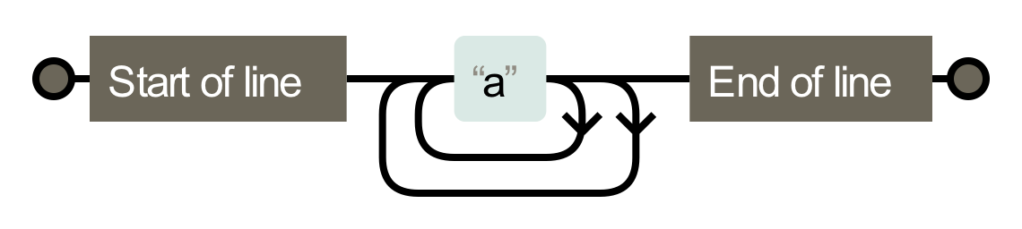
Ambiguity can lead to super-linear worst-case behavior
[A ‘80, C ‘03, C ‘07, KRT ‘14, S ‘14]
Super-linear regex /^(a+)+$/
NFA
Slow input “aaaaa…aa!”
Recurrence relation
T(n) = 2*T(n-1)
= 2*(2*T(n-2))
= O(2^{n})
Mismatch - backtracking
Exponential paths to explore
Notes:
* Here’s an example of a super-linear regex – it looks a lot like the previous example, but this regex has exponential worst-case behavior
* Regex engines will construct this NFA – like the previous NFA, but it has two loops instead of one
* because of the extra quantifier.
What effect does this extra loop have? It makes the NFA ambiguous.
* Each time the regex engine encounters an "a", it's not sure which loop to take.
Each "a" gives it two choices to explore.
After the first “a”, there were two paths.
After the second “a”, each of those two paths has two more paths – 2 times 2 is 4
After the third “a”, each of those four paths has two more paths – 2 times 4 is 8
These choices compound to yield an exponential number of possible paths.
This means that
* under the input "aaaa....a!",
* there will be an exponential number of paths to explore in the number of "a"s.
* This input ends in an !, ensuring that none of them will match and forcing the regex engine to try all of them.
* We can express the number of paths in this NFA using this recurrence relation, which works out to exponential in the length of the input.
* Not all regexes will have exponential worst-case time complexity under this search regime.
Some regexes exhibit polynomial worst-case behavior – I’ll show one in a moment.
And many regexes will exhibit linear worst-case behavior.
Regardless of their worst-case behavior, most regexes will run in linear time on typical inputs.
They exhibit their slowest behavior only on specially crafted inputs.
TRANSITION
Let’s review what we’ve learned so far with a real-world example.
===

Slide 11
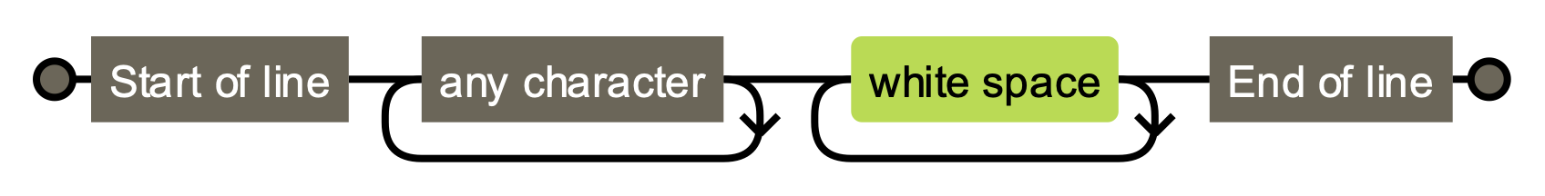

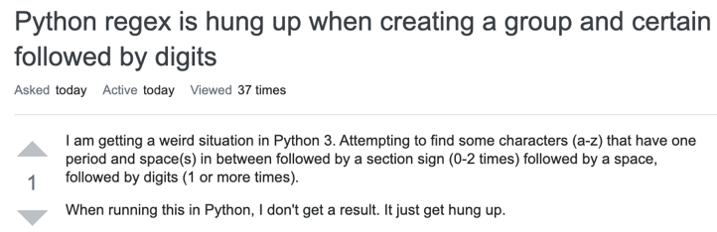

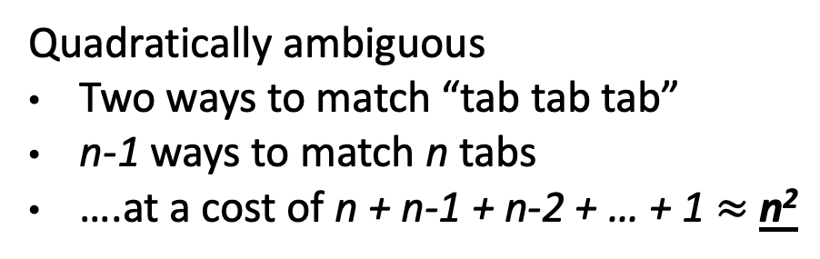
Stack Overflow Outage – July 2016
/^.*\s+$/
Quadratically ambiguous
Two ways to match “tab tab tab”
n-1 ways to match n tabs
….at a cost of n + n-1 + n-2 + … + 1 $≈$ n²
Notes:
Stack Overflow is an online question and answer forum, primarily used by computing practitioners.
In July 2016 they experienced a 34-minute service outage caused by a super-linear regex evaluation, preventing users from posing questions or answering them.
At a rough estimate, during this outage 200,000 visits were disrupted, affecting tens of thousands of users.
The cause?
* Stack Overflow posts look like this: a title, then a few lines of a question.
Responses look similar.
* You can't see this, but there is no whitespace at the beginning or the end of each line.
This makes sure that the posts look pretty on laptops, desktops, and mobile devices,
and also saves Stack Overflow a bit of money by reducing their network traffic.
* Stack Overflow stripped this whitespace using a regular expression.
* This regular expression is ambiguous -- you can match whitespace characters either in the first loop or the second one.
* There are quadratically many paths through it.
Quadratically many isn't too bad -- it grows slowly, so slow behavior only manifests on fairly long strings.
TRANSITION:
As it turns out, somewhere on Stack Overflow was a post with over 20,000 tab characters, and one day this post received a lot of traffic.
Let’s look at a system diagram to see what happened to Stack Overflow next.
====
In early 2020, Stack Overflow received about 10 million visits per day, so a rough estimate suggests that a 34-minute outage would affect over 200,000 possible visits.
Post #38484433 (20,507 whitespace characters in the middle of a line)

Slide 12







Regular Expression Denial of Service (ReDoS)
[C ’03, C&W ‘03]
/^.*\s+$/
“\t\t\t…\t!”
<normal traffic>
Notes:
Let’s say this is Stack Overflow’s server.
* They are applying this regex on posts –untrusted input from clients.
* If a malicious user (or just a bizarre one) creates a post with tons of tab characters,
* then SO’s server dedicates an unusual amount of computational resources to this regex match,
* And legitimate users
* are denied service – they cannot ask questions or give answers.
Crosby called this situation Regex Denial of Service, or ReDoS.
This kind of denial of service attack has two immediate effects.
First, as you can see, legitimate users cannot access the service.
* Second, a ReDoS attack costs the company providing the service money!
They are wasting computational resources (e.g. increasing their cloud spend).
And if the company uses an advertising revenue model, those lost clients also mean lost advertising dollars.
TRANSITION
Stack Overflow is not the only company to run into problems with runaway regex evaluations
====
Remember that regexes are commonly used for input validation.
Form input is, by definition, untrusted and potentially malicious -- that's why we're validating it.
A malicious input could trigger the super-linear worst-case match time of a regex, leading to denial of service.
=====
Regex Denial of Service was proposed back in 2003 by Scott Crosby.

Slide 13




Anecdotes of ReDoS in the wild (non-malicious)
July 2016 – 34 minute outage
July 2019 – 27 minute outage
September 2015 – Not exploited
Notes:
…Stack Overflow is not the only company to run into problems with runaway regex evaluations
* The CDN company CloudFlare had an outage caused by a quartic regex, affecting thousands of websites last July.
* MediaWiki, which is the platform on which Wikipedia and other wikis run, had an exponential regex. Thankfully they found it before it was exploited.
TRANSITION
I can show you many anecdotes of regexes being problematic, with implications for system security and correctness.
But unfortunately, the state of the art remains just that: anecdotal.

Slide 14

State of the art: What we know about ReDoS
[C&S‘16, S&P‘18, M‘19]
Web service
Untrusted input
Ambiguous regex
Slow regex engine
No safeguards
[W‘17, M‘19]
ReDoS =
[FSE’18, ASE’19]
[C’07]
[FSE’19]
[SECURITY’18]
[In preparation]
Notes:
... But unfortunately, the state of the art remains just that: anecdotal.
Let me explain what I mean by that.
The requirements for ReDoS are listed here:
We need a web service
Operating on untrusted input
Using an ambiguous regex
In a slow regex engine
With no safeguards for its worst-case behavior
ReDoS was first proposed in 2003, but researchers ignored it for about ten years.
More recently, we’ve begun to learn a lot about ReDoS.
Researchers have found that software engineers
* Commonly use regexes in web services – Check!
* And use these regexes to handle untrusted input – Check!
* We don’t know the extent to which the typical regex is ambiguous – Unknown!
* Cox has argued that many regex engines are slow, but has not quantified this – Unknown!
* And we don’t know the extent to which these slow regex engines have safeguards preventing problematic behavior – Unknown!
TRANSITION
In my dissertation research, I have found that
* many regexes are ambiguous
* that many regex engines are slow on these regexes
* and that existing safeguards are ineffective.
In other words, ReDoS is a security threat to real-world software.
Happily, I’ve identified safeguards that appear more promising.
Let’s start by talking about the potential impact of ReDoS…

Slide 15
Background
Impact
Defeat
Talk Outline
Research questions
Methodology
Results
Notes:
…Let’s start by talking about the potential impact of ReDoS…
TODO

Slide 16
Impact of ReDoS – Study design
Ecosystem-scale
Generalizability
How commonly does software rely on ambiguous regexes?
Do these findings hold:
Under other methods?
Across programming languages?
Notes:
TODO
TRANSITION
We’ll start by taking ecosystem-scale measurements of the use of ambiguous regexes

Slide 17











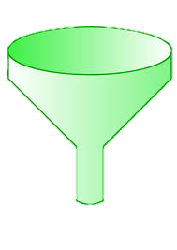



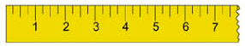

Ecosystem scale – Methodology
Software to study
Regex extraction
Regex corpus
565K
125K
“Can clone”
filter
350K
60K
375K
(66%)
70K
(58%)
Notes:
* We started by choosing software to examine.
We wanted to assess the risks facing an entire software ecosystem, so
* we examined as many JavaScript modules as possible
* in the Node.js package registry, NPM
* At that time, there were half a million npm modules,
* of which we could clone
* 375K from GitHub for analysis.
* To identify the regexes in these modules, we
* used static analysis to extract the arguments from regex-creating callsites
* After some time on a supercomputer, we obtained a regex corpus of
* 350K unique JavaScript regexes from these Node.js modules.
* Python
We also repeated this analysis for the Python module ecosystem, pypi, to see if our findings would generalize to another context.
TRANSITION
* Having collected all of this data, we then measured the corpus to answer our research questions.
===
45% JS projects had at least one regex
35% Python projects had at least one regex

Slide 18







Problematically ambiguous regexes are common
350K
60K
Ambiguous regex
detectors
[R&T ‘14]
[WMBW ‘16]
[WOHD ‘17]
35K (10%)
6K (10%)
[FSE ‘19]
1% exp.
99% poly. – quadratic
Notes:
Here we have an ecosystem-scale corpus of regexes.
How many of them could exhibit problematically ambiguous behavior in the worst case?
* To learn this, we applied three state-of-the-art detectors to search for problematic ambiguity in a regex's NFA representation.
* The detectors reported that some were safe (green) and others were potentially super-linear (yellow).
* Likewise for Python
* I then tested the potentially problematic regexes in Node.js and Python to confirm their behavior in the appropriate regex engine.
* Some were false positives, while others truly had super-linear worst-case behavior.
* Overall, I identified about 35 K super-linear JavaScript regexes
* And 6 K super-linear Python regexes
That's about 10% of the corresponding corpuses.
* To break this down further, about 1% of these regexes exhibit exponential worst-case behavior.
The rest have polynomial worst-case behavior, typically quadratic.
From this we learn that ReDoS regexes are commonly used in practice – thousands of ReDoS regexes occurring in over 10K modules.
When an application depends on these modules, it becomes potentially vulnerable to ReDoS.
TRANSITION
This research showed that problematically ambiguous regexes are fairly common, comprising a substantial proportion of all regexes -- that is to say, the regexes in THESE programming languages that can be obtained using THIS extraction methodology.
===
These detectors work on the “truly regular” subset of regexes, which is most of them.
Their analysis is predicated on certain assumptions about the regex engine in which the regex will be evaluated.
350K extracted from JS projects, and 60K extracted from Python projects
These regexes render their dependents make these modules, and well as any modules and applications that depend on them, potentially vulnerable to ReDoS.

Slide 19





ReDoS regexes occur in Prominent Places
1 regex
1 regex
3 regexes
2 regexes
3 regexes
Notes:
Every software ecosystem includes both important and unimportant projects.
We found problematically ambiguous regexes in all kinds of projects, including in some prominent places.
At the application and framework level, we found ReDoS regexes in
* MongoDB, the Hapi web framework, the Django web framework
And at the runtime level, we found ReDoS regexes in
* Node.js core libraries and Python core ibraries
These prominent ReDoS regexes have the potential to expose thousands of applications to ReDoS.
Each of these regexes was assigned a CVE number and was repaired in a security release.
TRANSITION
Next, we’ll talk about the generalizability of these and other findings.
===

Slide 20
Impact of ReDoS – Study design
Ecosystem-scale
Generalizability
How commonly does software rely on ambiguous regexes?
Do these findings hold:
Across programming languages?
Under other regex extraction methods?
Notes:
…Next, we’ll talk about the generalizability of these and other findings.

Slide 21
Do these findings generalize, or are they biased?
Corpus | Languages, # projects | Extraction method
[C ‘16] | 4K | Static analysis
[Just discussed] | ~400K | Static analysis
[W ‘18] | 1K | Prog. instrumentation
Does programming language affect results?
Does extraction method affect results?
Notes:
I'm not the only one whose research generalizability might be affected here.
All empirical regex research to date has made use of a small number of programming languages -- just Python, JavaScript, and Java -- and relied on a mix of extraction methods.
This raises questions for the generalizability of these projects.
* Maybe engineers use regexes differently in other programming languages,
* and maybe one extraction method doesn't work as well as another.
TRANSITION.
Let me illustrate one of these potential biases visually.
=======
Engineers may choose a programming language based in part on their task, and some tasks may have greater call for pattern matching. It is not unreasonable to suppose that the characteristics of the regexes used to solve these problems may likewise vary by programming language.
- Second, different extraction methods could yield different regexes. To illustrate this, let’s look at the next figure.

Slide 22


One potential bias – Programming language
Population
Relevant regexes
ISSTA’16
FSE’18 b
Sample
FSE’18 a
Notes:
Suppose this is the population of all regexes.
Now, most corpuses have sampled from
*Java projects,
*JavaScript projects,
and
*Python projects.
* But what about regexes from projects in other programming languages?
Perhaps software in these languages solves different problems with regexes,
and thus the regexes are of a different kind.
Without testing, we cannot be sure
how WIDELY SPREAD
issues like ReDoS actually are.
TRANSITION
Let me explain how I tested these questions.

Slide 23
Generalizability – Experimental design
Sample 1
Sample 2
Treatment variables: Programming language & extraction mode
Dependent variables: 8 regex metrics across 3 dimensions
Hypothesis tests: Kruskal-Wallis (non-parameteric ANOVA)
Effect size: Non-parametric Cohen’s d_{r}
Notes:
…Let me explain how I tested these questions.
* I extracted regexes into samples,
* measured the samples
* and performed statistical comparisons to see if they appeared to come from similar distributions
* As treatment variables, we used programming language and extraction mode
* As dependent variables, we used 8 regex metrics across 3 dimensions
* The distributions of our metrics were not normal, nor were the variances homogeneous.
So we used a non-parametric test: the Kruskal-Wallis test.
Because our corpus is large-scale, hypothesis tests alone are risky.
We have a lot of statistical power, and the tests may highlight significant (but minor) differences.
* We used Cohen’s non-parametric d to measure effect sizes.
----
https://en.wikipedia.org/wiki/Kruskal%E2%80%93Wallis_one-way_analysis_of_variance
..
So, after performing the Kruskal-Wallis hypothesis test, we calculated effect sizes for pairwise differences between groups. Because the distributions of regex characteristics do not meet the conditions assumed by parametric statistical tests, we applied a nonparametric difference effect size measurement dr derived from the commonly used Cohen’s d [67]. The dr measure is a scaled robust estimator of Cohen’s d proposed by Algina et al. [68], and shown to be robust to non-normal and non-homogeneous data [69]. It takes on scaled values indicating the size of the difference between two samples, ranging from 0 (no difference) to 1 (large difference).
https://help.xlstat.com/s/article/what-is-the-difference-between-a-parametric-and-a-nonparametric-test?language=en_US
Parametric tests assume underlying statistical distributions in the data. Therefore, several conditions of validity must be met so that the result of a parametric test is reliable. For example, Student’s t-test for two independent samples is reliable only if each sample follows a normal distribution and if sample variances are homogeneous.
Nonparametric tests do not rely on any distribution. They can thus be applied even if parametric conditions of validity are not met.

Slide 24
Generalizability – Results
Corpus | Languages, # projects | Extraction method
[C ‘16] | 4K | Static analysis
[D ‘18] | ~400K | Static analysis
[W ‘18] | 1K | Prog. instrumentation
A bit
Does programming language affect results?
Does extraction method affect results?
No
Notes:
We found some evidence that programming language matters.
Measuring the effect sizes, for half of the features there was a medium or large effect size in Perl, JavaScript, and Ruby. (The other programming languages all had similar populations).
We found minimal evidence that extraction method matters.
Here, although hypothesis tests indicated that the populations were different,
the effect sizes came back small to negligible.
Although there are differences between some treatments on some metrics,
we think that the trends for each metric are consistent to be useful for data-driven regex tools and system designs.
Most critical for our study, however, is that we found comparable numbers of ambiguous regexes under each treatment.
TRANSITION
Alright, that sums up the two studies on the use of ambiguous regexes in practice. Ambiguous regexes are widely used in software written in many programming languages.
Now we’ll talk about another ReDoS requirement.

Slide 25
Impact of ReDoS – Study design
Regex engine variations
Are all regex engines equally slow?
[Cox 2007]
Notes:
…Now we’ll talk about another ReDoS requirement.
We took as granted that web services accept untrusted input.
* I just discussed two studies on the use of ambiguous regexes in practice.
* Now I’ll briefly cover a study on the next ReDoS requirement: A slow regex engine.
* Here, our question is whether all regex engines are equally slow?
* Prior work has asserted that regex engines fall into two tiers: slow ones that use the backtracking algorithm, and fast ones that use a linear-time algorithm known as Thompson’s algorithm.
In this experiment, we will test this claim.

Slide 26









Experimental design
537K regexes
vs.
Notes:
Given what we’ve talked about already, the design of this experiment was straightforward.
* In the generalizability study, we collected a corpus of 537K regexes from 8 programming languages.
As we did in the first study, we applied regex ambiguity detectors to identify potentially-super-linear regexes from this corpus.
* To test the extent to which each regex engine exhibits worst-case behaviors, we tested each ambiguous regex in each of the eight programming languages considered so far.
TRANSITION
We found that regex engines can be categorized into three tiers of performance, not two.
=====
* Since there was some variation between worst-case behaviors, we then compared the extent to which some engines consistently performed better than others.

Slide 27
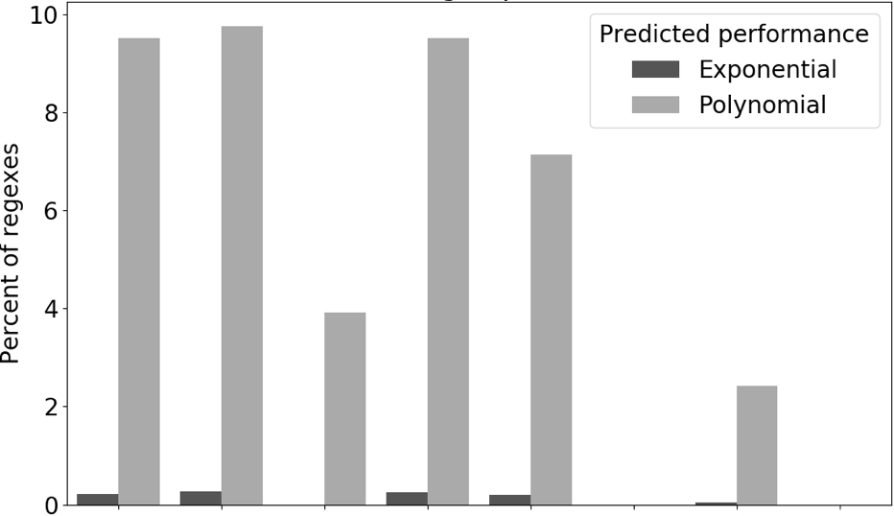


Slow, Medium (!), and Fast tiers
Slow
Worst-case performance
Medium (!)
Fast
Notes:
…We found that regex engines can be categorized into three tiers of performance.
For each regex engine, this chart shows the percent of the regex corpus that exhibited exponential or polynomial worst-case behavior.
* First, we have four regex engines in the “slow tier”. These exhibit comparable levels of exponential behavior and polynomial behavior, with 7-10% of regexes running in super-linear time.
* Then, we have two regex engines in the “fast tier”. These use Thompson’s matching algorithm instead of backtracking, and exhibit no super-linear behavior.
* Finally, we have two regex engines in a “medium tier”. These exhibit almost no exponential behavior and noticeably less polynomial behavior. This tier has been ignored in prior work; its superior performance can be attributed to a mix of optimizations and safeguards that bear further study.
These truly are tiers -- on a pairwise basis, there is almost monotonic improvement from one tier to the next.
TRANSITION
These findings tell us that ambiguous regexes may be more dangerous in some regex engines than others.
That wraps up what I’d like to say about the potential impact of ReDoS.

Slide 28
Impact of ReDoS – Summary of findings
Web service
Untrusted input
Ambiguous regex
Slow regex engine
No safeguards
ReDoS =
Ecosystem-scale
Generalizability
Regex engine variations
Notes:
…That wraps up what I’d like to say about the potential impact of ReDoS.
Through large-scale studies, I have found that
*10% of regexes are problematically ambiguous
* That this finding is generalizable across PLs and Extraction methods, and
* That some regex engines are more dangerous than others.
TRANSITION
I therefore hope that I have persuaded you of the first part of my thesis:
That ReDoS is a security threat to real-world software.

Slide 29
Background
Impact
Defeat
Talk Outline
ReDoS is a security threat to real-world software.
Notes:
…I therefore hope that I have persuaded you of the first part of my thesis:
ReDoS is a security threat to real-world software.
TRANSITION
So what should we do about it?
In the third part of this talk, I will present the findings from a systematic evaluation of the ReDoS solution space.

Slide 30

Background
Impact
Defeat
Talk Outline
Solution space
Four defenses
Ideas
Methodology
Results
Notes:
…In the third part of this talk, I will present the findings from a systematic evaluation of the ReDoS solution space.
I will provide a framework by which to understand the evaluation, and share the ideas, methodology and results for four defenses.
TRANSITION
Let’s start with the framework.

Slide 31

Defeating ReDoS: The solution space
Web service
Untrusted input
Ambiguous regex
Slow regex engine
No safeguards
ReDoS =
2: Change the regex
3: Substitute regex engine
1: Safeguards
4: Speed up regex engine
Notes:
…Let’s start with the framework.
ReDoS arises when these five conditions are met. I hope they are familiar by now.
* We will take it as a given that software engineers operate web services,
* And that they handle untrusted input.
A ReDoS defense cannot tamper with these two conditions, but we can consider the other three.
These defenses can be erected in two places of a software application:
* In the software itself, and in the regex engine on which it relies.
In my studies, I considered the effectiveness of four defenses:
* worst-case safeguards,
* either in the application or the regex engine
* changing ambiguous regexes,
* in the application
* Substituting a faster regex engine,
* in the application
* And speeding up an existing regex engine,
* in the regex engine itself
As you’ll learn next, what I found is that
* Safeguards can be effective,
* Current techniques for changing the regex are not safe,
* Substituting the regex engine is risky,
* And speeding up the regex engine can be effective
TRANSITION
* Let’s start by looking at safeguard-style solutions.

Slide 32



Solution 1: Safeguards
Time-oriented resource cap
10 seconds
/(a+)+/.exec(“aaa”, new TimeSpan(10))
Algorithm-oriented resource cap
10 steps
Notes:
…Let’s start by looking at safeguard-style solutions.
These solutions enforce a cap on the amount of resources that a regex match can consume.
These safeguards currently take two forms.
* Time-oriented resource caps are measured in wall-clock time at the application level
* They look something like this: A regex match, with a 10-second cap requested.
* Algorithm-oriented resource caps are measured in terms of the number of steps that the regex engine takes.
* The regex engine builds an NFA as usual,
* And during simulation it
* Counts how many steps it takes.
If it exceeds a limit, it gives up and returns an exception.
TRANSITION
In practice, this type of ReDoS defense is available in three regex engines.

Slide 33

Resource caps – Effectiveness and adoption
Time-oriented resource cap
Default: off
10 seconds
Algorithm-oriented resource cap
Default: on
2 definitions
10 steps
How effective are the three approaches?
Have engineers adopted the time-oriented cap?
Notes:
…In practice, this type of ReDoS defense is available in three regex engines.
* Time-oriented caps are available in
* The .NET framework (C#)
* Algorithm-oriented caps are implemented in
* the regex engines of PHP and Perl
* The time-oriented caps are off by default,
* while the algorithm-oriented caps are on by default.
* They also come in two different flavors.
This leads us to two questions:
* First, how effective are the three approaches?
* Second, since the time-oriented caps are off by default – if you build it, will they come?
TRANSITION
Any student of human nature could probably guess our findings.

Slide 34


Resource caps – Experimental results
Effectiveness
10 ms
100% effective
51K ambiguous regexes
default
48% effective
default
2% effective
Adoption
Global
Constructor Per-call
1% protected
135K
35K
Notes:
…Any student of human nature could probably guess our findings.
* In terms of effectiveness, we experimented with the 51K ambiguous regexes from our regex corpus.
* In C#, we tested them with a 10 ms timeout.
* In PHP and Perl, we used the default values for the resource thresholds.
* We found that the time-oriented resource caps were perfectly effective,
* While the approach of PHP was 50% effective
* and that of Perl was abysmal.
* However, in terms of adoption, we found that “if you build it, they WON’T come”.
* Using our typical techniques, we studied C# modules
* We cloned 35K modules
* and used static analysis to identify cases where the time-oriented resource cap was applied.
* Unfortunately, only 1% of regex calls -- and 1% of SUPER-LINEAR regex calls -- were protected with timeouts.
* This is of course a bit ironic -- the C# developers have access to the most effective defense, but rarely use it.
TRANSITION: We decided to explore a solution that offered the best of both worlds:
The effectiveness of a time-oriented resource cap with default-on adoptability.
We developed this solution for Node.js, a popular web framework.
Because a default-on timeout changes programming semantics a bit, we opted to protect against a wider range of security vulnerabilities: ReDoS among other risks.
We called the resulting defense mechanism FIRST CLASS TIMEOUTS.
I can’t dive into the details too much, but I’ll run through a system diagram of my system design.

Slide 35

Resource caps – First-Class Timeouts
Application
Node.js libs
V8
JS Engine
JS
C++
Event-ing
libuv
Time-aware JS
Event loop
Worker pool
Time-aware Event Loop
Time-aware Worker Pool
Notes:
…I can’t dive into the details too much, but I’ll run through a system diagram of my system design.
Node.js is a popular web framework used by many Fortune 500 companies.
A Node.js application sits on top of
* Google’s V8 JS engine,
* And interacts with Node.js’s core libraries
* Node uses the event-driven paradigm by integrating with the libuv library
* To implement First-Class Timeouts,
* I modified the JS engine to give it a sense of time,
* and then tweaked libuv to create a time-aware event loop
* and a time-aware worker pool.
TRANSITION
The resulting system offers strong security guarantees against ReDoS and related application-level DoS attacks.
Let’s see it in action.
==========
(Can go through this more quickly if time is pressing)
This is how a Node.js application works under the hood.
* The code in the Node.js application is executed by the V8 JavaScript engine.
* This code can rely on Node.js libraries, both JS and C++.
* The event-driven aspect of the runtime is implemented using the libuv library, which offers both an
* Event loop and a worker pool.
That’s the vanilla Node.js runtime.
To implement first-class timeouts,
* I first made the JS engine aware of time, adding a Timeout Exception and handling mechanism.
* Then I modified the event loop to monitor how long it spends processing events on behalf of each client.
* I similarly modified the worker threads to track how long they spend on each task.
In my prototype, whenever a client event or task takes too long, an exception is delivered.
This prototype was built on Node version 8, and introduced about 4KLoC across 50 files.
Using a mix of macro- and micro-benchmarks, we found that our prototype adds latency overheads of about 10%.
TRANSITION
Let’s see its behavior:
========
I did not include details like:
- Safe killing of Tasks ($5.2, pthread_setcancelstate)
- Performance optimizations ($5.5)

Slide 36
Prototype behavior
Malicious input injected
Notes:
Here we see the effect of a REDOS attack against a simple Node.js server.
This server can handle about 1500 requests per second, until
* ReDos is triggered via malicious input, and
* the event loop stops processing events, leading to denial of service.

Slide 37

Prototype behavior
Malicious input injected
TimeoutException delivered
Notes:
Now I’ve added the maroon line showing the behavior of the prototype.
You can see there’s some overhead – its steady-state throughput is 5-10% lower.
But half a second after the malicious input is injected,
* our modified runtime delivers a First-Class Timeout to the application,
and service is restored.
The application can then blacklist the attacker so it cannot repeat the attack.
TRANSITION Alrighty, so that's my evaluation of the "safeguards" defense.
In summary, existing approaches of this kind are either ineffective or not adopted.
Our prototype seeks the best of both worlds, but still requires application-level refactoring.
The next ReDoS defense we'll consider is refactoring -- changing the regex to be safe.

Slide 38
Defeating ReDoS: The solution space
Web service
Untrusted input
Ambiguous regex
Slow regex engine
No safeguards
ReDoS =
2: Change the regex
3: Substitute regex engine
1: Safeguards
4: Speed up regex engine
Notes:
... The next ReDoS defense we'll consider is refactoring -- changing the regex to be safe.

Slide 39




Solution 2: Change the regex
Original /\S+@\S+\.\S+/
3 fix strategies
Trim TRUNCATE(input, 1000)
Revise /^[^@]+@([^\.@]+\.)+$/
Replace (Custom parser)
Exactly one @
A ‘.’ to the right of the @
Ambiguous
x 284
Notes:
In this study, we first identified common fix strategies in previous ReDoS vulnerability disclosures, and then we evaluated how safely engineers can follow these strategies.
* To illustrate, here we have the email regex from the beginning of the talk.
* This regex is ambiguous -- the "non-whitespace loops" can consume @ symbols, so a string of @ symbols will take quadratically many steps to reject.
* By examining 37 previous ReDoS repairs, we identified 3 fix strategies.
* First, engineers sometimes Trimmed the input, effectively bounding the worst-case behavior
* Second, engineers sometimes Revised the regex to an unambiguous alternative.
* Third, they sometimes replaced the regex with appropriate string logic.
TRANSITION
To understand how safely engineers can follow these strategies,
* I emailed about 300 software engineers to disclose a ReDoS vulnerability in their software, and then observed their repairs.

Slide 40


Fix preferences and correctness issues
Uncommon
Notes:
My disclosures yielded 48 patches from module maintainers.
* This histogram shows the distribution of fix strategies.
3 patches used Trim, about 30 used Revise, and about 15 used Replace.
I’ll make two observations about these results.
* First, leaving the regex unchanged and merely trimming the input was unusual.
The engineers thought this was a lower quality fix.
Future work on automatic security patch generation should take these preferences into consideration.
* Second, repairing ReDoS regexes is error prone!
I worked with the engineers in private to validate their patches.
Many of their first (…and second…and third) patch attempts did not address the REDOS problem.
In the 37 historical fixes, which did not have my help, several of the “patched” vulnerabilities were actually still vulnerable.
So, fixing ReDoS regexes seems to be a difficult engineering task.
TRANSITION
* In summary, ReDoS regexes can be repaired, but engineers don't currently seem to have the appropriate tools to effect these changes safely.
There is room for future work in this direction.
... The next ReDoS defense we'll consider is substitution -- changing the regex engine for a faster one.
====
Revising minimizes the number of changed lines, although the underlying complexity may be significant.

Slide 41
Defeating ReDoS: The solution space
Web service
Untrusted input
Ambiguous regex
Slow regex engine
No safeguards
ReDoS =
2: Change the regex
3: Substitute regex engine
1: Safeguards
4: Speed up regex engine
Notes:
... The next ReDoS defense we'll consider is substitution -- changing the regex engine for a faster one.

Slide 42

Solution 3: Substitute the regex engine
Notes:
Here’s the intuition behind this approach.
In my earlier experiments, I found that there are three tiers of regex engine performance.
Moving from a slower tier to a faster one decreases your risk of ReDoS.
* So suppose you have a JavaScript application
* By default, it uses the built-in JavaScript engine.
* But at the application level, you can load in a different regex engine – say this fast one from Rust.
This will solve your ReDoS problems – but it might give you correctness problems instead.
Although each regex match will be faster, if the match BEHAVIOR varies from one engine to the next, you might be in trouble.
TRANSITION
In this study, we measured the extent and causes of variations in match behavior between regex engines.

Slide 43

Compatibility of Regex Dialects – Methodology
/\cC/
Does
match “cC” ?
Yes
No
Regexes
Input generators
Regex testers
Rex, MutRex, EGRET, ReScue*, BRICS*
537K regexes
Regex semantic analysis
(pairwise)
Notes:
...In this study, we measured the extent and causes of variations in match behavior between regex engines.
Let me show an example:
* We have a query: Does this regex match this string?
* In Python, the answer is yes
* In JavaScript, the answer is no.
The root cause: Python v3.5 interprets \c as a literal c character, while JavaScript treats it as "ctrl-C".
To identify such differences in a systematic manner, we used
* our large regex corpus
* combined with input generators to create queries
* and evaluated using instruments that measure regex behavior in each regex engine
* All this together equals regex semantic analysis, performed pairwise to compare between pairs of regex engines.
TRANSITION
In this semantic analysis, we looked for four possible different behaviors.
===
Using our input generator ensemble, we produced about 2500 unique inputs for the median regex.
* ReScue: modified to emit the randomized inputs it explores in its search for super-linear behavior
* BRICS: modified to emit random subsets of inputs instead of an exhaustive set (infinite / very large for our purposes)

Slide 44

Compatibility of Regex Dialects – Summary
/\cC/
“cC”
Both match? | Same substring? | Same captures?
No difference
Capture
Difference witnesses
Substring
Match
15% of regexes (82K) had a difference witness
7% had a capture witness
4% had a substring witness
8% had a match witness
Notes:
…In this semantic analysis, we looked for four possible different behaviors.
Given two regex engines, a regex, and an input,
* We can check their behavior against this table.
* They might agree perfectly: that there is a match, on the same substring, with the same captured groups.
* Or they might disagree – maybe the captures are different,
* or perhaps the substring is different,
* Or perhaps they disagree about whether there is a match at all.
* We call this last group Difference Witnesses – a regex,input pair that elicits a difference between some pair of regex engines
* We found that difference witnesses are not rare. Fully 15% of the regexes participated in a difference witness between some pair of regex engines.
TRANSITION
We looked at the root causes of these differences. Today, I’ll categorize them into three groups.
========
We identified at least one difference witness for 15% of the regexes.
These are regexes that compiled in some pair of languages but disagreed in some way about the match.
Among those:
8% of the regexes had a match witness
4% had a substring witness
7% had a capture witness
This means that, ceteris paribus, about 15% of the time a developer copy/pastes a regex across a language boundary it will have different behavior in the new programming language. Assuming the behavior of the regex in the old language was “correct” according to application semantics, some regex porting will be required.

Slide 45

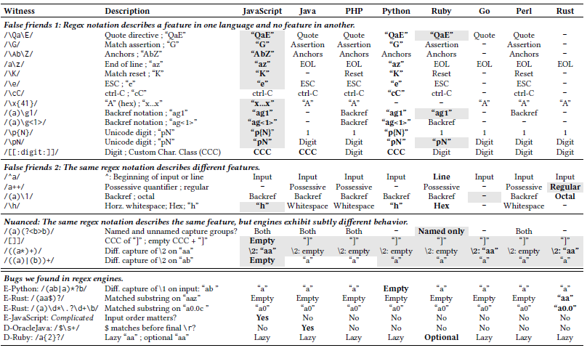


Compatibility of Regex Dialects – Characterization
Notes:
…We looked at the root causes of these differences. Today, I’ll categorize them into three groups.
This table shows all of the differences we identified, through a mix of manual and automatic analysis.
* In this first group are behavioral differences that are well documented and can be easily addressed through a translation layer using existing compiler techniques.
* In the second group are behavioral differences that seem harder to translate – they don’t follow documentation, so they can only be discovered through experiments like this one. Some of them could then be translated, others less so.
* In the third group are regex engine bugs. We found these through differential testing – 7 of the engines agreed, and one did something unaccountable. We reported these to the maintainers, leading to fixes in Python, JavaScript, and Rust.
TRANSITION
In summary, in this experiment we found that changing regex engines will bring security from ReDoS – but at the risk of introducing correctness errors into your software. Care should be taken when porting a regex from one engine to another, and thorough, representative test suites will be critical in this process.
The final solution I’ll discuss is acceleration: speeding up an existing regex engine.
====
This chart breaks down the differences we identified by comparing the behavior of a <regex, input> pair in different programming languages.
Grey cells: behavior that is not specified in the documentation
Two noteworthy regions of this chart:
The same regex notation describes the same feature, but it behaves differently. The difference in behavior appears to be a legitimate interpretation of the regex specification, but these appear difficult to faithfully translate. The differences are typically not documented, and so without these experiments a translation effort would be hazardous.
The examples at the bottom are also examples of different behavior between regex engines. Unlike the previous set, there’s no good reason for these differences. The development teams have confirmed these are bugs in the relevant regex engines.
TRANSITION:
TODO

Slide 46
Defeating ReDoS: The solution space
Web service
Untrusted input
Ambiguous regex
Slow regex engine
No safeguards
ReDoS =
2: Change the regex
3: Substitute regex engine
1: Safeguards
4: Speed up regex engine
Notes:
…The final solution I’ll discuss is acceleration: speeding up an existing regex engine.

Slide 47
Solution 4: Speed up the regex engine
How can we make a backtracking regex engine faster…
…without changing match behavior
…or paying too much
Notes:
In the previous experiment, we found that it would be difficult to substitute a faster regex engine for a slower one – you would get better match performance, but at the risk of affecting the correctness of your software due to semantic changes.
Here, I consider
* How we can make a backtracking regex engine run faster
* Without changing its match behavior
* And without paying too much in other dimensions, like space and engineering cost
TRANSITION
The approach we’ll consider is called memoization.
It has been proposed in the past, but no one has figured out how to make it cheap enough to be practical.

Slide 48


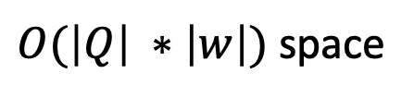
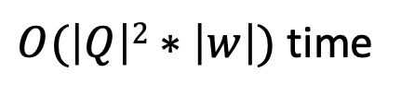
Approach: Full memoization
/(a+)+/
“aa…a!”
Node 1, offset 1
“a” (outer loop)
“a” (inner loop)
Node 1, offset 2
Node 1, offset 2
“a” (outer loop)
“a” (inner loop)
“a” (inner loop)
Node 1, offset 3
Node 1, offset 3
…
…
$O(\left|Q\right|2∗\left|w\right|)$ time
Theorem 1: Memoizing visits to every vertex yields
$O(\left|Q\right| ∗\left|w\right|)$ space
Similar to Packrat Parsing for CFGs [Ford 2002]
Notes:
…The approach we’ll consider is called memoization.
It has been proposed in the past, but no one has figured out how to make it cheap enough to be practical.
Let me explain first how FULL MEMOIZATION works.
* We’ve got our input, and the regex engine will simulate the automaton on this input.
Earlier I explained how regex engines work.
They employ a backtracking search,
and explore every potentially-feasible path through the automaton.
So while matching "aa!", we'll see simulation paths like these:
* We start at node 1 (the node marked "a"), at string offset 1
* When we see an "a", we have a choice of the inner or the outer loop
* Let's favor the inner loop, so we'll move to node 1, offset 2, and try the other path later
* We'll keep doing this and eventually mismatch
* Then we'll backtrack -- let's suppose we try the other choice back at the beginning
Now we're at Node 1, offset 2 again.
* From there, we can get to node 1, offset 3 again, and so on
You can see that we're retracing our steps along different paths.
The NFA simulation is visiting the same vertices at the same offsets over and over again.
That makes sense when you look at the definition of ambiguity.
A regex is ambiguous if there are multiple paths in the automaton that lead to the exact same place – it would be redundant to try both of them.
A natural solution to avoid redundant paths is a technique called memoization.
Essentially, memoization introduces bread crumbs into the NFA simulation,
and if the simulation encounters a bread crumb then it knows that that path didn’t work.
During the simulation, we can mark the node-offset pairs as we visit them, like so
*
*
Then when we backtrack, we can see the redundancy and short-circuit those paths.
I’ve proved an unsurprising theorem about this:
If we memoize visits to every vertex, the simulation will run in linear steps for the input w,
And it will require the one copy of the string for each vertex being memoized.
TRANSITION
I've implemented a prototype regex engine to illustrate this approach.
Let’s take a look at its performance.
=====
Also note that unlike changing the core algorithm, with memoization it is easy to prove that the engine’s semantics will be preserved.

Slide 49
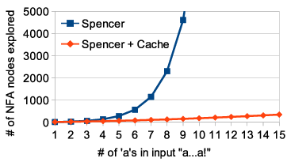
Prototype – Time cost of full memoization
/(a+)+/
Linear time complexity
“aa…a!”
Backtracking
Exponential time
Linear time
Memoized
Number of steps
Notes:
…Let’s take a look at its performance.
This chart shows the number of steps in the NFA simulation for this exponential regex.
The blue line is the current behavior of most regex engines.
The orange line is the behavior of our prototype.
* As expected, memoization changes the worst-case behavior
* from exponential to linear growth
TRANSITION
This approach offers a great improvement in time complexity.
But what about space costs?

Slide 50
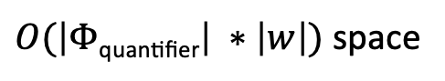

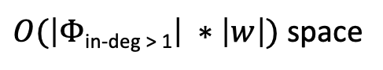

Reducing space costs via selective memoization
[Acar 2003]
30x: too much space
Vive la différence
Typical space multipliers
Tighter distribution
Selected set of NFA vertices
Same time cost
Theorem 2: Memoizing visits to $Φ$_{in-deg > 1} yields
$O(\left|Φ\text{in}\text{−}\text{deg}\text{ > 1}\right| ∗\left|w\right|)$ space
Larger time cost in Q
Theorem 3: Memoizing visits to $Φ$_{quantifier} yields
$O(\left|Φ\text{quantifier}\right| ∗\left|w\right|)$ space
Notes:
…This approach offers a great improvement in time complexity.
But what about space costs?
A full memoization scheme requires making as many copies of the input string as there are NFA vertices.
How many NFA vertices do regexes typically have?
This chart shows the distribution of NFA sizes for the regexes from our corpus, i.e. the typical space multiplier for memoization.
* If we memoize all vertices, we’ll need 20 to 40 copies of the input string for typical regexes.
In some cases this might be acceptable.
But if input strings can be long, this space cost may be too much for practical purposes.
For example, the Stack Overflow problem from earlier involved very long input strings -- adding an order of magnitude to the memory costs in such cases could be problematic.
* Fortunately, I have shown that we can memoize a selected subset of the vertices, obtaining the same time guarantee with lower space cost.
* For 99% of real-world regexes, this set of states is consistently quite small.
* I've gone further, and shown that we can memoize still fewer vertices to trade a slightly larger time cost for even less space.
* This nets us a slightly tighter distribution than the previous scheme.
TRANSITION
So far so good – using selective memoization, we can dramatically reduce the space cost without degrading the linear time guarantee.
Can we do better?
=======
The 75th percentile of both all regexes and only the super-linear regexes is between 30 and 40 (31 and 38, respectively)
Whiskers are the (1,99) percentiles.
Measure is of 150K regexes from the corpus of 537K, i.e. about 29%.
The remainder use features that the prototype does not support.

Slide 51
Efficiently storing the memo table: Full table
/(a+)+/
“aa!”
Vertex A
Vertex B
Vertex
1. Full memo table
 | A | B
1 - a
2 - a
3 - !
Fast access
Wasted space if unvisited
String offset
Notes:
…So far so good – using selective memoization, we can dramatically reduce the space cost without degrading the linear time guarantee.
Can we do better?
I’ll look at three ways to STORE the memo table, and we’ll see which one can do so the most efficiently.
* We’ll start out with what’s called a full memo table.
* Each column is the memoization record for a vertex
* Each row corresponds to an offset in the string
* We start by marking the outcome at each vertex-offset pair as unknown
* As we find cells that don’t work during the simulation, we’ll replace them
* with xs
During the simulation, if we encounter an X we know it won't work and can short-circuit. If we encounter an unknown, we will explore it.
* This scheme can be implemented with a bitmap, for fast access.
* It might waste a lot of space though – in column B we paid for a full copy of the input string that we didn’t use
TRANSITION
Perhaps we can do better by only paying for what we actually use.
=======
Whiskers are the (1,99) percentiles.
Measure is of 150K regexes from the corpus of 537K, i.e. about 29%.
The remainder use features that the prototype does not support.

Slide 52
Efficiently storing the memo table: Negative table
/(a+)+/
“aa!”
Vertex
2. Negative table
 | A | B
1 - a
2 - a
3 - !
Fast-ish access
No wasted space
String offset
 | A | B
1 - a
2 - a
3 - !
1. Full memo table
Notes:
…Perhaps we can do better by only paying for what we use.
* This approach is called a negative table – we’ll only mark places that WON’T work. This is a traditional technique in memoization.
* Again we have columns for vertices
* And rows for string offsets
* This time, we’ll start out with an empty table
* As we find failed paths, we’ll mark those
But we’ll never pay for cells we don’t visit.
* If we use a structure like a hash table, this gives us fast access and no wasted space.
TRANSITION
But perhaps we can do even better, by tailoring our table encoding to the problem context.
=======
Whiskers are the (1,99) percentiles.
Measure is of 150K regexes from the corpus of 537K, i.e. about 29%.
The remainder use features that the prototype does not support.

Slide 53
Efficiently storing the memo table: Run-Length Enc.
/(a+)+/
“aa!”
[Robinson 1967]
Vertex
3. RLE
 | A | B
1 - a
2 - a
3 - !
log(k) access
Run length affects compression ratio
String offset
1. Full memo table
2. Negative table
Notes:
…But perhaps we can do even better, by tailoring our table encoding to the problem context.
Look at the bottom two tables here – at the end of the simulation, both are low entropy, with a single value reused in every row – eminently compressible.
Perhaps we can take advantage of this low entropy by maintaining a compressed version of the memo table.
It turns out that we can achieve this by applying Robinson’s Run-Length Encoding.
* Here’s the table again.
This time, we’ll break up each column into runs, each of which is either a sequence of UNKNOWN or a sequence of KNOWN-FAILURE.
* We’ll start with one run of UNKNOWN per column.
* During the simulation, we introduce a run of KNOWN-FAILURE.
* But this run accretes during the simulation – we maintain low entropy throughout.
Why does this work?
Intuitively, this is caused by the backtracking search strategy necessitated by regex engines’ leftmost-greedy semantics.
The simulation follows a top- to-bottom, left-to-right search, exploring nearby string indices before further ones. This has the consequence that any runs within these automaton nodes will accrete as characters are processed, yielding consistently low entropy within each column.
* With an efficient data structure, we get logarithmic access to the columns, and low expected storage costs.
TRANSITION
Let’s see how these selection and encoding schemes stack up.

Slide 54
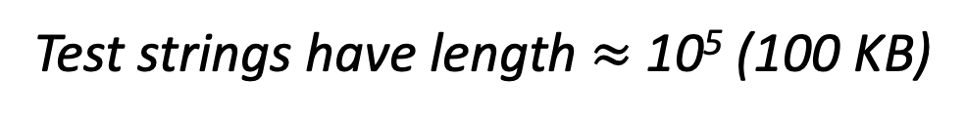
Selection scheme + RLE = constant space costs
Test strings have length $≈$ 10⁵ (100 KB)
Selection + RLE = 95% constant!
1 – 100 MB is a lot of space for a regex engine
Most table entries are used
Notes:
…Let’s see how these selection and encoding schemes stack up.
This chart shows the distribution of space costs for the 13K super-linear regexes supported in the current prototype, about 30% of all of the SL regexes in our corpus.
The x-axis is the selection scheme, the y-axis is a LOG SCALE, and the colored bars represent the space costs for the various encoding schemes.
* The test strings have length on the order of 10^5-6.
* Multiplied by NFA sizes, we end up with significant space costs using full memoization.
Using selective memoization, the costs go down significantly, but we are still making copies of the input string itself.
* You can see that the blue and orange costs are similar; most table entries are used, so negative tables don't help too much.
* Run-length encoding, however, is super effective. For 95% of the regexes we tested, the compression scheme is perfect.
TRANSITION
In summary, it appears that the combination of selective memoization and a good encoding scheme can eliminate ReDoS with minimal space costs. Perhaps there is such a thing as a free lunch.

Slide 55
Background
Impact
Defeat
Talk Outline
Existing solutions are ineffective or impractical.
Our new approaches appear promising.
Notes:
I hope I have persuaded you of the second part of my thesis:
Although existing ReDoS solutions are ineffective or impractical, our new approaches appear promising.

Slide 56


Background
Impact
Defeat
Publications
Recommendations
&
Future work
FSE’18
Security’18
FSE’19
ASE’19
In prep.
Notes:
The work I've discussed has appeared in several publications, with more in preparation.
* Before I wrap up, I'd like to share a few recommendations and ideas for future work.

Slide 57

Recommendations and future work
Web service
Untrusted input
Ambiguous regex
Slow regex engine
No safeguards
ReDoS =
2: Change the regex
3: Substitute regex engine
1: Safeguards
4: Speed up regex engine
Notes:
In the first part of this presentation, I described my findings indicating the ReDoS vulnerabilities may be widespread in practice.
In the second part of this presentation, I evaluated a range of solution approaches according to this conceptual framework:
Safeguards through resource caps
Refactoring the regex for an unambiguous equivalent
Substituting the regex engine for a faster one
Speeding up an existing regex engine
Here are my recommendations for practitioners:
Resource caps are effective, but carry a refactoring burden. Perhaps this is an option for future systems.
Regex refactoring is possible, but difficult; we should not ask individual engineers to solve this problem piecemeal. Automatic refactoring may be a solution, but requires advances in theory as well as empirical understanding of engineers’ preferences.
Substituting a regex engine for performance benefits is possible, but risky from a correctness standpoint. Regexes must be ported from one dialect to another. While some of these translations are trivial, others had to be discovered through experimentation.
Selective memoization appears to be effective, backwards compatible, and readily incorporated into existing regex engines. We recommend that practitioners pursue this approach in the short term.
Some suggestions for future work:
Automatic refactoring approaches are promising. We suggest that researchers combine the theoretical work from van der Merwe with empirical findings from myself and Chapman on engineers’ refactoring and comprehension preferences.
Formalizing regex engine dialects will permit sound regex engine substitutions, as well as enabling the systematic testing of regex engines for other defects. Campeanu and Berglund have begun this effort, but it is not yet completed.
In this dissertation, I only considered safeguards that MONITOR for worst-case behavior. Techniques from machine learning and automata theory might be applied to a novel class of safeguards that can PREDICT worst-case behavior based on the regex and the input string.
My selective memoization techniques appear promising! Future work in this area includes optimizing the choice of run length, measuring the cost of handling extended regex features like backreferences, and evaluating the engineering cost of an implementation in a production-grade regex engine.
TRANSITION As I wrap up, I'd like to thank my collaborators on these and other projects.

Slide 58












Big thanks to my collaborators!
Notes:
As I close, I’d like to thank my collaborators on these and other projects,
*From Virginia Tech,
*IBM Watson and IBM Almaden,
*and the University of Bradford
TRANSITION
In summary...I have presented arguments that ReDoS is a security threat to real-world software,

Slide 59
Closing remarks
Background
Impact
Defeat
/a+/
Thesis
ReDoS is a security threat to real-world software.
Existing solutions are ineffective or impractical.
Our new approaches appear promising.
Notes:
In summary: (Read the thesis).
Let me close with these thoughts.
Regular expressions are an ancient technology, predating most aspects of modern programming.
That regexes are STILL widely used in modern software is a testament to their U-tility. That regexes are a widespread security risk could be interpreted as a testament to FU-tility.
Engineering secure software is a difficult task, from the social aspects of human operators to the technical challenges of secure systems design. When even the fundamental building blocks of software are a security risk, it is hard to say with any confidence that software can truly be made secure. But we have also shown that this tool can be made secure in a backwards-compatible manner. There is hope that one security vulnerability, at least, can be made a thing of the past.
With that, thank you for your attention! I’m happy to answer any of your questions.

Slide 60
Bonus slides

Slide 61
Personal motivation

Slide 62



Regexes!
Notes:
Some of you might be wondering why my research focuses on regexes.
The answer is hiding here on my LinkedIn profile.
Before coming to grad school, I spent a few years on a software product team at IBM.
My job was to test the software, and one of my roles was to ensure that the command-line interface was still working.
And guess what?
*A common way to test a CLI is to encode valid output using a regex. I probably wrote and maintained hundreds of regexes during my time at IBM, and got a really good sense of the value of this technology for practitioners.
--------
which produces human-friendly output rather than machine-friendly output, and which might change a bit from release to release –

Slide 63
Background

Slide 64
What is a regex?
Concept
Notation
String language
Supported in all PLs
TREs (automata theory)
EREs (backreferences)
NP-hard
Pattern Matches
ab “ab”
a* “aaa”
a|b “a”, “b”
(ab) \1 “ab ab”
Notes:
Language: a subset of all possible strings

Slide 65
What do software engineers use them for?
30-40% of Python and JavaScript projects
Diverse purposes
User-agent string → Server-side rendering
File names → Command-line tools
Tokenizing → Lexers
HTML → Browser plug-ins
Email → Input validation
[C&S ‘16]
[D et al. ‘18]
Notes:
Regexes are widely used, estimated to appear in 30-40% of Python and JavaScript projects.
They are used for diverse purposes.
My prior empirical work has identified many common application areas, including
User-agent string: For example, rendering a webpage to take advantage of features available only on Google Chrome
Source code: e.g. to enforce coding conventions like camelCase
File names: e.g. to validate input for a CLI
Tokens: e.g. for a lexer to tokenize some source code
HTML: e.g. for a browser plugin to manipulate web page
Email: e.g. to do form validation

Slide 66
Regexes 101
/a+/
Concept
Core operations
String language
~40% of SW projects
[Chapman ‘16]
ab ab
a* a, aa, aaa, …
a | b a, b
Exponential
Worst-case behavior
Poly-time
[Aho ‘80]
[Crosby ‘03, Cox ‘07] [KRT ‘14, Sugiyama ‘14]
Linear
Notes:
Regular expressions are a popular tool for string matching problems.
A historical note:
Regexes are actually a relatively ancient technology, at least within computing.
Can be traced to early work in neuro-science in the 1940s
Let me summarize three things you’ll need to know about them.
First, regexes are a means of encoding a
* Regular language: some useful subset of all possible strings, like “strings that look like email addresses”
They are supported in all mainstream PLs, and are widely used in practice.
* By one estimate, about 40% of software projects use regexes in one way or another.
Second, engineers encode string constraints using
* three core regex operations:
* Concatenation, * repetition, * disjunction
Most programming languages offer about 30 distinct regex operations
PAUSE.
* The Third thing you should know about regexes is that their worst-case behavior can be really slow.
Most regexes run in linear time for typical inputs – otherwise engineers wouldn’t use them!
* But various researchers have showed that
* Although some regexes have linear worst-case match time,
* Other regexes will have polynomial
* Or even exponential worst-case match times as a function of the length of the input
===
* Practitioners have extended regular expressions beyond automata 101.
Real-world regexes are expressive enough that you can encode NP-hard problems with them.

Slide 67
Real regex examples mined from GitHub
/.+$/ ← “Chars”
/\d{1,3}\.\d{1,3}\.\d{1,3}\.\d{1,3}/ ← IPv4
/^[a-zA-Z0-9]+([._]?[a-zA-Z0-9]+)*$/ ← Username
Super-linear “ReDoS regex”
Notes:
To give you a few more examples,
here are some regexes we mined from real software available on GitHub.

Slide 68
Regexes can be ambiguous – \S+ @ \S+ \. \S+ and “@@@@.@”
[B&T ‘10]
\S+
@
\S+
\.
\S+
@@
@
@
.
@
@
@
@@
.
@
Notes:
When I say ambiguous, I mean that there is a string for which there is more than one path through the maze.
Let’s try this strange-looking string: “a bunch of @ symbols with a period in the middle”
* Here’s one path through the diagram
* And here is a second path through the diagram
TRANSITION

Slide 69
Perl’s regex engine: Original copyright 1986
/* NOTE: This is derived from Henry Spencer's regexp code...
* Thanks, Henry!
* . . .
* Copyright (c) 1986 by University of Toronto.
* Written by Henry Spencer. Not derived from licensed software.
*/

Slide 70





CloudFlare Outage – July 2019
CPU utilization (all machines)
100%
75%
50%
25%
0%
Ambig. regex rolled back
Outage
Ambig. regex deployed
13:45 13:50 13:55 14:00 14:05 14:10
Notes:
CloudFlare is an internet infrastructure company whose main offering is a content delivery network -- basically a cache for web services.
CloudFlare has a lot of customers: around 5% of all internet traffic flows through CloudFlare.
Last July, CloudFlare had an outage caused by an algorithm that began to receive worst-case inputs.
While CloudFlare was offline, its customers' services were inaccessible, impacting the bottom line
of companies like Uber, OKCupid, and Peloton.
CloudFlare’s engineers had developed an algorithm that run in linear time on most input.
They tested it on a small-scale deployment, and it performed just fine.
But when CloudFlare’s engineers deployed this algorithm worldwide, things went wrong.
A pathological group of network packets triggered the algorithm’s worst-case cubic behavior – much worse than the linear-time behavior they were expecting.
* This chart shows the CPU utilization on their servers during the outage.
* When the algorithm was deployed, CPU utilization spiked to 100%. Network traffic could not be processed because the machines were overloaded.
* Until CloudFlare’s engineers responded, many Internet services were disrupted.
TRANSITION
This outage at CloudFlare is a perfect example of Denial of Service through Algorithmic Complexity.
So, what was the problematic algorithm?
The SPECIFIC problem that brought down CloudFlare was a regular expression with super-linear worst-case match performance.
As I’ve found through my research, this class of vulnerability is fairly common.
In the rest of today’s talk, I’ll share my research into identifying and eliminating denial of service vulnerabilities like this one in practice.
===
This algorithm typically behaved in linear time, but as the result of a change by CloudFlare's engineers it began to perform in cubic time on many inputs.
Some affected websites:
https://www.theverge.com/2019/7/2/20678958/downdetector-down-cloudflare-502-gateway-error-discord-outage
Other CloudFlare customers:
https://qz.com/918941/cloudflare-leaked-user-data-from-millions-of-websites-heres-how-to-check-if-you-were-affected/
5-10% of internet traffic:
https://www.wired.com/story/cloudflare-spectrum-iot-protection/
other web services might be vulnerable to an outage caused by a runaway regex.

Slide 71

Denial of Service via Algorithmic Complexity
“Susie”
Algorithmic complexity
Worst-case input
Time
Average input
Input size
Notes:
PAUSE.
* Once upon a time, there lived a web server
* Let's say it's an Outlook mail server
For many moons this server operated correctly.
But one day...
* villainy!
An attacker
* sent the server malicious traffic.
* SOMEHOW, this traffic caused the server to perform a lot of computation, diverting resources away from legitimate users.
* This meant that users like Susie
* were unable to access their email.
* The degraded service caused the service provider to lose revenue, and eroded its customers’ confidence
PAUSE.
This is the typical tale of a denial of service attack, but I've omitted a key detail:
* What might this malicious traffic look like?
There are many forms of DoS attacks, corresponding to different types of traffic.
Today I'll focus on a particular type of DoS attack called an Algorithmic Complexity attack.
* Suppose this is the time complexity of the algorithm used by our service.
* It performs well on average-case inputs,
* But on “worst-case” inputs, our algorithm performs quite slowly.
If our service receives enough “worst-case” input, it will incur a great deal of computational load, and may eventually overwhelm our ability to handle legitimate clients.
TRANSITION
For an example of such an outage in practice,
let me tell you about an incident last summer at a company called CloudFlare.
===

Slide 72



Regular Expression Denial of Service (ReDoS)
[Crosby ‘03]
/(?:(?:\"|'|\]|\}|\\|\d|(?:nan|infinity|true|false|null|undefined|symbol
|math)|\`|\-|\+)+[)]*;?((?:\s|-|~|!|{}|\|\||\+)*.*(?:.*=.*)))/
“+++…+++”
<normal traffic>
Notes:
Remember that regexes are commonly used for input validation.
Form input is, by definition, untrusted and potentially malicious -- that's why we're validating it.
A malicious input could trigger the super-linear worst-case match time of a regex, leading to denial of service.
We call such behavior Regex Denial of Service, or ReDoS.
* Here we have our web server again – this time it’s not hypothetical,
and Cloudflare is playing the role of service operator.
* CloudFlare was using this worst-case cubic-time regex
* And on receiving worst-case network packets,
* Its servers became overloaded
* Normal traffic
* Couldn’t be handled in a timely manner
* Affecting the bottom line of CloudFlare’s customers, including
* Uber, OKCupid, and Peloton
TRANSITION
CloudFlare is not the only company to run into problems with runaway regex evaluations
=====
Regex Denial of Service was proposed back in 2003 by Scott Crosby.

Slide 73
Impact

Slide 74
Why modules?
Modules are critical infrastructure
Modules are comparable building blocks
Strings
Math
Command-line scripting aids
Graphics

Slide 75
Why not applications?
Open-source applications may not be representative of code in industry
Module ecosystems are shared by open-source and industry
Modules are sometimes authored by industry as a way to give back to the open-source community

Slide 76
Impact FSE’18 measurements

Slide 77




ReDoS @ JavaScript: 10% of npm vulnerabilities
SECURITY’18
Notes:
CloudFlare isn’t the only company that has been affected.
During a paper I published at USENIX Security with these fine gentlemen, we categorized the security vulnerabilities reported in the JavaScript module registry npm.
According to Snyk.io, which maintains the largest such database, about 75% of the DoS vectors – or 10% of all reported security vulnerabilities – were caused by regular expressions.

Slide 78

/a+/
From anecdotes to empiricism
Notes:
And if you’re generous, I MIGHT persuade you that there MAY BE something wrong with regexes.
But anecdotes aren’t enough to motivate fundamental changes in programming languages or in systems design.
* Scientists and engineers need an empirical foundation on which to build.
* My empirical research has provided this foundation, investigating the factors that lead to ReDoS issues in practice.

Slide 79
Super-linear regexes are Usually Quadratic
Notes:
This figure shows...
x-axis: empirical curve
y-axis is percent of ReDoS regexes with that curve
orange is npm, maroon is pypi
Results
Most ReDoS regexes exhibit quadratic behavior as the input length increases.
Exponential-time ReDoS regexes are rare.
Trends similar in npm and pypi
Implication
TRANSITION
OK, so we now have evidence that super-linear regexes are fairly common in two ecosystems.
Is this finding biased by the programming languages we picked?
What about by the regex extraction approach we followed?

Slide 80
(ReDoS) Regexes Are Hard to Understand
[CWS ‘17]
/^(\+|-)?(\d+|(\d*\.\d*))?
(E|e)?([-+])?(\d+)?$/
/([^\=\*\s]+)(\*)?\s*\=\s*
(?:([^;'"\s]+\'[\w]*\’
[^;\s]+)|(?:\"([^"]*)\")|
([^;\s]*))(?:\s*(?:;\s*)|$)/
/^\S+@\S+\.\S+$/
/^(.*?)([.,:;!]+)$/
/<(\/)?([^ ]+?)(?:(\s*\/)| .*?)?>/
/^([\\s\\S]*?)((?:\\.{1,2}|[^\\\\\\/]+?|)(\\.[^.\\/\\\\]*|))(?:[\\\\\\/]*)$/
/^(\\/?|)([\\s\\S]*?)((?:\\.{1,2}|[^\\/]+?|(\\.[^.\\/]*|))(?:[\\/]*)$/
/\+OK.*(<[^>]+>)/
/\s*#?\s*$/
/^\s*/\*\s*(.+?)\s*\*/\s*$/
Notes:
To give you a taste of the problem faced by developers,
here are some of the ReDoS regexes that we reported.
They are long, and they are complicated.
We wanted to know how developers go about fixing ReDoS vulnerabilities like these ones,
in order to inform future research on automatic ReDoS regex amelioration.

Slide 81
Methodology
Historic
Disclosures & Fixes
Study all ReDoS reports in CVE and Snyk.io DBs
“What do developers prefer when they know all the fix strategies?”
Email 284 module maintainers
Vulnerability disclosure
Fix strategies
Notes:
Part 1
CVE: General DB for security vulnerabilities in software
Snyk.io: Module-specific security vulnerability DB that includes npm and pypi modules.
Part 2: We selected modules based on:
- Downloaded >1000 times/month
- Manual inspection for seriousness (potential for ReDoS exploitability)

Slide 82
Fix Strategies For RedoS Regexes
Original /^\S+@\S+\.\S+$/
Fix strategies
Trim TRUNCATE(input, 1000)
Revise /^[^@]+@([^\.@]+\.)+$/
Replace* (Custom parser)
Exactly one @, somewhere in the middle of the string
A ‘.’ to the right of the @
But not immediately to the right
Notes:
This example is taken from a discussion we had with the Django development team.
*The fact that they match different sets of strings is surprising.
In fact there’s been some work from van der Merwe et al. who tried to revise REDOS regexes but only in a language-preserving way. They were excited to hear that they can be more aggressive in their proposed revisions.

Slide 83

Fix strategies and correctness
1 incorrect
2 incorrect
“All correct”
Notes:
We observed different trends in the strategies used by developers in the historic data vs. after our disclosures.
Axes
X-axis: Fix strategy
Y-axis: Number of times it was used
In total there are 37 historical fixes, with most in Revise but more than 5 of the others.
Compare that to the 48 fixes resulting from our disclosures.
Decrease in Trim
Developers exposed to all 3 fix strategies opted not to Trim
Correctness
So...fixing ReDoS regexes seems to be pretty hard for developers to do correctly.

Slide 84
Impact Generalizability

Slide 85

Generalizability concerns in prior work
“These results may not generalize to other languages.”
Widely used…
…for many purposes
Varying feature use
Under-tested
Security vulnerability
ISSTA’16
FSE’18 a
“unknown whether our findings will hold for other languages”
ISSTA’16
→ ASE’17
FSE’18 b
→ SANER’19
“﻿The regexes reflect one language”
FSE’19
Notes:
Empirical regex usage has primarily been studied by Katie Stolee’s lab at NC State, and my team at Virginia Tech.
*Stolee’s team said regexes are widely used. They appear in about a third of Python projects
*My team reported that engineers use regexes in diverse contexts for diverse purposes, including:
input validation
server-side rendering
*Stolee’s team reported on which features are more popular
which guided the design of their regex comprehension experiment.
*Stolee’s team also reported that regexes are under-tested,
which motivated their work on regex evolution.
*This year, my team reported that up to 10% of regexes could lead to security vulnerabilities if used on untrusted input.
Clearly we know some things about the properties of real regexes, and how engineers use them.
Our teams have also been pretty honest about the threats to validity:
*These results may not generalize to other languages
*Unknown whether our findings will hold for other languages
*The regexes reflect only one language
Next we’ll take a deeper look at the regex corpuses (population samples) on which these findings are based.

Slide 86
What’s a regex corpus, and why do I want one?
Q: How to extract regexes?
Typical regex practices
Popular and unpopular features
Extent of super-linear regexes
→ Tool builders, regex engine devs.
Notes:
*We’d like to understand how software engineers use regexes in practice.
*To make sure our results aren’t biased, we can’t just look at one project – we’ll need to look at a bunch.
*Suppose we have a magic means of extracting regexes from software projects.
Then we can build a collection of all of the regexes people use in the wild.
*We can use this for…
→ “all sorts of insights that will benefit regex tool builders and regex engine developers
*So – how should we extract regexes?

Slide 87


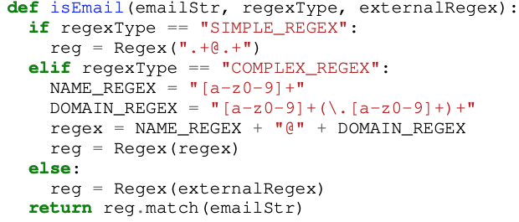
How have researchers built regex corpuses?
Programming language ←
Software ← Applications, modules
Extraction methodology ← “Static” and “Dynamic”
Notes:
Note that static extraction is fairly straightforward, while “dynamic extraction” – instrument the program or runtime, then execute the software – is more difficult to scale to many projects and multiple languages.

Slide 88
Experimental design
Programming language ←
Software ← Important open-source modules
Extraction methodology ← Let’s try both!
Research question: Does it matter which extraction methodology we follow?
Notes:
More formally, we want to know whether there is a measurable difference between regexes extracted using one methodology or the other.

Slide 89





Regex collection methodology (125K regexes)
Module regex extraction
Module selection
. . .
Static analysis
Prog. Instr.
“Important”
Top 25K
Notes:
We collected regexes like this.
For each language, we identified the largest module registry.
We mapped those modules to GitHub and sorted them by the number of GitHub stars they have, which gave us a registry-independent measurement of importance.
*For each of the top 25K modules, we applied both previously-used regex extraction techniques to build sets of regexes extracted one way or the other.
*After we repeat this for 25K modules, these can BOTH rightly be said to be a JavaScript regex corpus. But is there any difference?
For this we need to characterize a regex, preferably quantitatively.
The next part of our project was collecting a set of metrics to characterize a regex across three dimensions considered in prior work.

Slide 90
Regex metrics
Representation
String length
Features used
NFA size
Language diversity – matching strings
Complexity
DFA size
Super-linear behavior (“ReDoS regexes”)
Use of advanced features

Slide 91
Within a Prog. Lang., the two competing regex extraction methodologies yield indistinguishable regex corpuses
(So let’s use the easier methodology!)
Notes:
Slide, then:
Takehome message
We believe our study shows that:
ReDoS is a very real problem in practice, and that
The practitioner community needs better tools to detect and repair ReDoS regexes.

Slide 92
Potential bias #2: Extraction methodology
ISSTA’16, FSE’18 a, FSE’19
Static analysis-based
ExpressionStatement
/abc/
FSE’18 b
Program instrumentation-based
Test suite
Notes:
Let me illustrate this sampling bias.
*Which we then walk for regex creation sites

Slide 93

Generalizability hypotheses
Sample
Population
H-EM: The Extraction Methodology does not matter.
H-PL: The Programming Language does not matter.
Notes:
*H-EM: Extraction methodology
- Static analysis and program instrumentation will yield similar regex corpuses.
*H-PL: Programming language
- Regexes from different programming languages will be similar.
*These are fairly natural hypotheses.
- For extraction methodology…If you look at source code, you'll see that most regexes are declared inline, where either static analysis or program instrumentation can find them.
- For programming language… Using regexes ourselves, reading textbooks, and looking at Stack Overflow posts: it seems natural that the kinds of problems people solve with regexes won't seem too much -- they are STRING OPERATIONS, which are fairly general. So we would expect the regexes to look similar across programming languages.
If both of these hypotheses hold, researchers can generalize results from one extraction methodology in one programming language to all programming languages – that would be great!
If either fails, we will need to be more cautious in generalizing our findings.
Either way, with these hypotheses tested we can move on from the task of laying an empirical regex foundation to the more practical tasks of building tools and regex engines to help developers.
-----
It's uncommon to see regexes defined in unreachable code (where PI couldn't find them) or in external files (where static analysis couldn't find them).

Slide 94
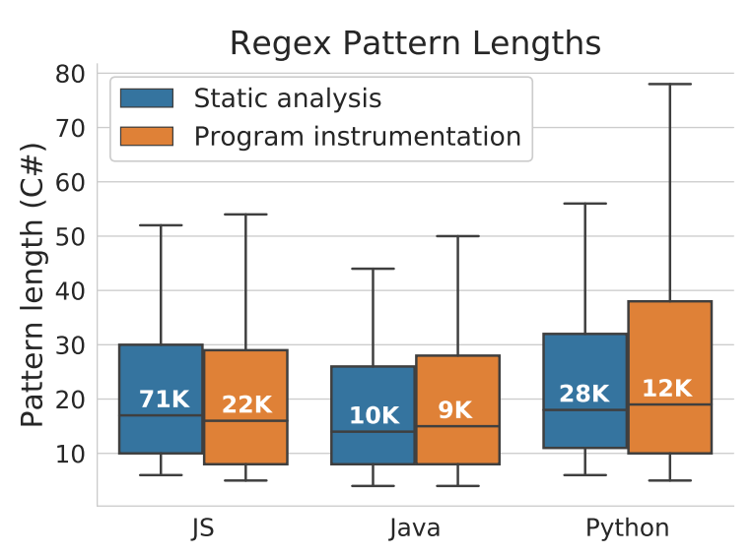
Representative results (all charts look like this)

Slide 95



Experimental methodology
1. Extracting regexes
H-EM
75K projects
Both extraction methodologies
H-PL
200K projects
Static extraction
2. Measuring regexes
14
regex
corpuses
/a/
Measured corpuses
Notes:
First we extract regexes, then measure them, then test hypotheses.
*H-EM:
Static analysis: standard tools for each programming language
e.g. JavaParser framework for Java, ast/astor for Python
Program instrumentation:
Same tools to instrument the code
Then we had to build and run as many of the 75K projects as we could
Overall
We obtained regexes from about 40% of projects statically,
and about 15% of projects using program instrumentation.
*H-PL
Because H-EM didn’t find any difference, we re-used the 8-language corpus from our prior work.
------
JavaScript: npm
Java: Maven and Gradle, including all versions of Android
Python: Less standardization. 5 popular build systems

Slide 96



Regex corpus
Num. modules
Unique
regexes
25K
150K
”
20K
”
45K
”
45K
193K modules
580K unique regexes
”
150K
”
20K
All (30K)
140K
All (10K)
2K
Notes:
In total, we extracted regexes from 193K modules written in 8 programming languages.
After accounting for duplicates, this gave us a polyglot corpus of about half a million unique regexes.
---
193,524 modules
As you can see, we found more regexes in some languages than others.

Slide 97
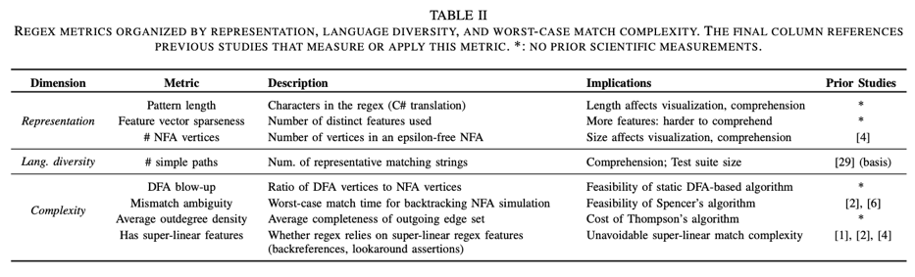

Slide 98
Findings
H-EM
Minimal evidence to reject
H-PL
Some evidence to reject
4/8 features
Notes:
We found minimal evidence to reject H-EM
Hypothesis tests failed because N is large in our dataset - we had a lot of statistical power.
But when we measured the effect sizes, we found only a small to negligible effect for each metric.
Some evidence to reject H-PL
Here the hypothesis tests failed as well.
Measuring the effect sizes, for half of the features there was a medium or large effect size in Perl, JavaScript, and Ruby.
*Although there are differences between some treatments,
we think that the trends for each metric are consistent to be useful for tool builders and engine developers.
Next we’ll look at one visualization for each hypothesis.

Slide 99
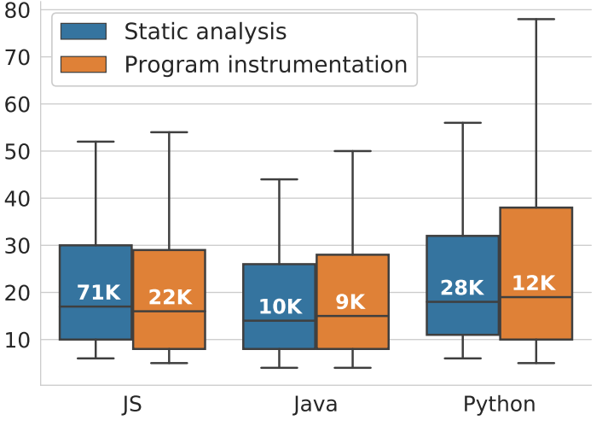


H-EM: Minimal evidence to reject
Regex length by prog lang
Length
“Significant” differences → Negligible effect sizes
Notes:
We found minimal evidence to reject the Extraction Methodology hypothesis.
I’ll share one representative finding.
This chart shows the distributions of regex length by
programming language (x axis) and
extraction methodology (blue static, orange instrumentation)
The whiskers are 10/90, outliers not shown.
*For this hypothesis, we’re comparing the pairs within each programming language.
*Our hypothesis tests reported a significant difference in medians, but the effect sizes are negligible here. Note how close together the medians are.
This is a representative figure; the other 7 metrics have similar properties.
----
This means we could find no practical difference between the samples obtained using the two extraction methodologies.
→ We interpret this to mean that in terms of the regexes themselves, the extraction methodology you use does not matter. That’s good news – static analysis is a lot less work.
Intersection:
About 50% of prog. instr. also found using static analysis
20K unique to prog instr, 20K overlap

Slide 100
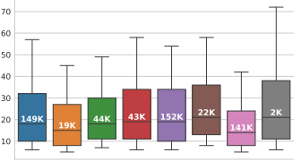
H-PL: Difference #1: <
Regex pattern lengths
Length
Notes:
We found some evidence to reject the Programming Languages hypothesis.
For some metrics, a few languages were outliers.
I’ll share one finding.
This chart again shows the distributions of regex length, by programming language (x axis)
*For this hypothesis, we’re comparing across programming languages.
In this case, between most pairs of languages there was no difference.
*But Perl regexes tend to be shorter than those used in Go, Rust (medium effect size).
3 of the other 7 metrics had significant differences.
See paper for details.

Slide 102
Highlighting two limitations of this research
ReDoS: Regex + reachability [W et al. 2017]
Generalizing modules to applications
Notes:
Of course, our work has some limitations.
I want to highlight two of them.
Reachability
Did not consider reachability of ReDoS regexes, in part for reasons of scale.
This is complicated by the fact that we were analyzing modules rather than applications,
Even if a regex were reachable from a module API that does not tell us how an application will use that module.
Our experience and measurements suggest that regexes are commonly used for input validation, but this would be worth revisiting
ReDoS regex == ReDoS?
This is not just about reachability; it concerns deployment.
ReDoS generally requires an application containing a ReDoS regex to be deployed on a server
that handles untrusted input.
It would be interesting to study how modules are used and whether we can predict their usage context based on README, the APIs they use, etc.
Despite these limitations, we believe that having ReDoS regexes in your module or application is a liability, whether or not they are currently reachable by user input, or deployed on a server today.
This is because in our regex corpus we found many examples of regexes that appear to be copy/pasted from one module to another, or derived from StackOverflow.
In one case a ReDoS regex was duplicated over 2000 times.
Thus, a ReDoS regex used in a safe context can easily pollute code used in a sensitive context.
Why have we accepted these limitations so far?

Slide 103
Impact Qualitative findings

Slide 104




158 Respondents: “We re-use regexes across languages”
Methods
IRB-approved survey
Respondents
The median respondent:
3-5 years of professional experience
medium-size company
intermediate regex skill
Key results (in this paper – see also ASE’19)
94% of developers re-use regexes
When re-using, developers are rarely confident that the regex comes from the same programming language
Notes:
94% of respondents reported re-using regexes at least 25% of the time.
We asked them how often they knew the regex was being re-used in the same language.
They were rarely confident that this was the case.

Slide 105
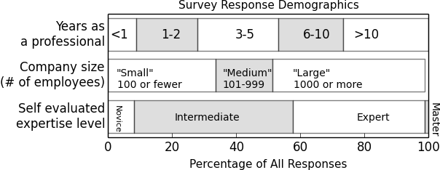
Survey methodology and respondents
33 questions, closed / open-ended. IRB.
Regex process, re-use practices, and portability
Median developer
Notes:
*Design
*Delivery
Responses:
About half from direct and transitive acquaintances.
About half from Reddit/HN.
*This figure summarizes the demographics of our respondents on working years, size of company, and regex expertise.
*The median respondent:
has 3-5 years of professional experience,
works at a medium-size company,
and claims intermediate regex skill.
--------
They were fairly diverse set on these metrics
Ranged from first-year developers to career professionals
Worked at small-to-large companies
Self-report: some novices, many intermediate/expert

Slide 106
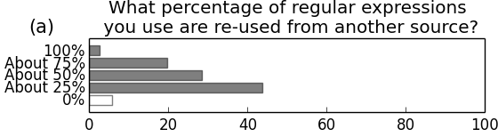
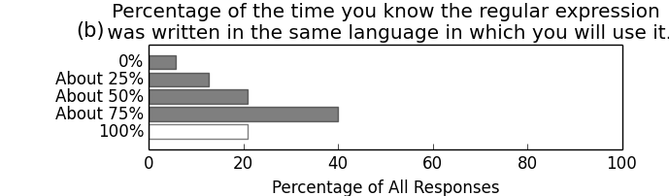
Respondents re-use regexes across languages
94% of developers re-use regexes
When re-using, developers are rarely confident that
the regex comes from the same programming language
Notes:
94% of respondents reported re-using regexes at least 25% of the time.
We asked them how often they knew the regex was being re-used in the same language.
They were rarely confident that this was the case.

Slide 107
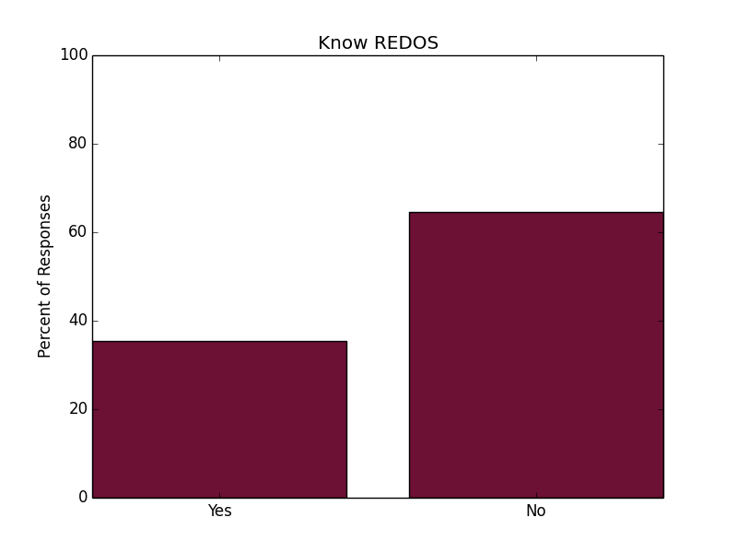
Many engineers do not know about ReDoS

Slide 108
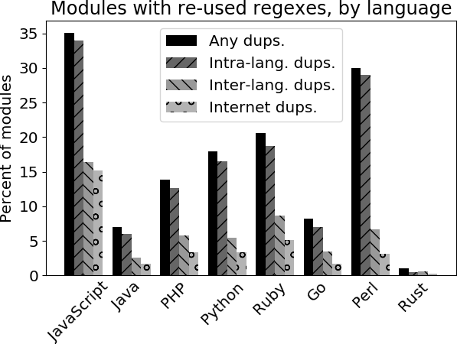


“Complex” regex re-use by module
Notes:
In building our regex corpus, we tracked the regexes extracted from each module.
To understand regex re-use, we measured the extent of re-use between the modules in our registry sample.
This chart plots the percent of modules that contained a complex regex that appeared in more than one module.
This is what I mean by “complex”: To eliminate trivially identical regexes like /\s/, we conservatively require any matching regexes to be at least 15 characters long.
We report that
*In 20% of all modules, we found a complex regex that appeared in some other module, in the same or a different programming language,
*About 7% of the corpus modules contain a complex regex that appears in more than one language,
and
*5% of the corpus modules contain an exact copy of a regex we found on Stack Overflow
Most common in JS – 15% of the JavaScript modules
These measurements generally corroborate the description of regex practices from our survey.
It appears that, like our survey respondents,
the developers of open-source software also copy-paste regexes, including across language boundaries.
----
By complex I mean it is at least 15 characters long -- and thus unlikely to be independently derived.
Although some of these regexes may have been derived by other means – independent creation, whole-sale file duplication, etc. …

Slide 109
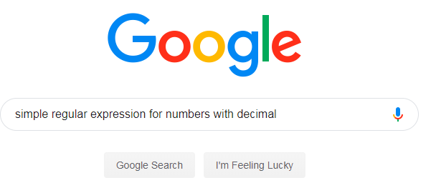
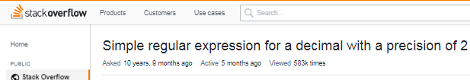
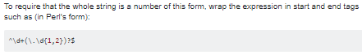





The regex development process
← 583K views
1.23
^\d+(\.\d{1,2})?$
\n1.23
Notes:
Here’s a typical example of the regex development process, based on results from our developer survey.
*Great, let’s put it into our Ruby program.
*We’re good software engineers, so we write a test case, which it passes.
Unlike most code snippets, regexes can flow unchanged across language boundaries.
Programming languages have similar regex syntaxes, so re-used regexes may compile without modification.
However, surface-level syntactic compatibility can mask more subtle portability problems.
For example, if regex semantics vary, then a regex will match different sets of strings across programming languages, resulting in logical errors.
*Here in Ruby, another input also passes – this time unexpectedly.
*I wanted to require the whole string to match, but in Ruby the ^ anchor only restricts to the beginning of each line within the string.

Slide 110
Defeat

Slide 111
Defeat Refactor regex

Slide 112
Heuristics Used in Practice
Our Heuristics
Finding Heuristics
Exponential
Reference books
Regex websites
What they said
Star height
“Watch out when different parts of the regex can match the same text”
Star height
(
)
Q.O.D.
(a|a)
Q.O.A.
a
a
Polynomial
Notes:
Finding Heuristics
We reviewed ~10 reputable reference books purchased from Amazon
And the advice given on several prominent websites dedicated to regexes
What they said
Avoid nested stars – this is the root cause of the exponential example we discussed earlier.
This heuristic is widely used; an npm module called “safe-regex” uses it and gets about 20M DL/mo.
Vague language: Operationalize into two heuristics.

Slide 113


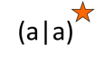

Few false negatives
Many false positives
Developed detectors for these heuristics
Imprecise – modeled on safe-regex implementation
Notes:
Axes
X-axis: Each heuristic
Y-axis: Percentage
Few false negatives
In total we capture about 81-85% of the ReDoS regexes in our dataset.
High false positives
Speaks to the power of the ReDoS regex detectors we used in the first theme.
We therefore recommend that developers adopt those tools, and to this end have published our drivers on GitHub.

Slide 114
Bringing Research to Practice
I am now the maintainer of safe-regex
Fixed false negatives in star height heuristic
Incorporating (improved) QOD and QOA heuristics
Notes:
Maintainer
20 M DL/month
Last week I published the first release in 4 years, fixing some false negatives in the star height heuristic.
Transition
So,
In the first theme we studied the incidence of ReDoS regexes in the wild,
and in this theme we studied how developers currently detect ReDoS regexes.
We also wanted to know how developers repair ReDoS regexes when they learn about them.

Slide 115
Defeat Faster regex engine via substitution

Slide 116

What-if experiments using regex testers
match regex against input
if match:
emit matched substring
emit capture groups
else:
report “no match”
“Capture
group”
/(\d+).\d+/
&
3.14
Match
substring “3.14”
capture “3”
Notes:
To perform our what-if experiments, we used a common set of regex testers.
The regex testers all follow the same simple algorithm: …
We implemented this algorithm in each of these languages.
*As an example, suppose we have the regex … and the input “3.14”.
*This regex will match the input. It will match the substring “3.14” – the whole string, in this case.
The regex contains one capture group, the integer prefix of the string, and our tester will also emit the contents of this group.

Slide 117
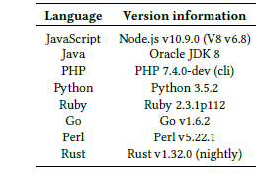
Language versions used in experiments

Slide 118

Some sample results of semantic differences
Witness | Language 1 | Behavior 1 | Language 2 | Behavior 2
\cC |  | ctrl-C |  | “cC”
^a |  | Begin input |  | Begin line
a++ |  | Possessive quantifier |  | Quantifier
[ ] ] |  | “]” |  | Empty capture group
Undocumented behaviors
Notes:
The full details of the differences we identified are in the paper, but I’d like to show you some illustrative findings here.
The first behavior is the “expected” behavior (normal across several languages), while the second behavior is the “surprising” behavior – unique to the language or shared by a few.
Regex engines are complex and under-specified, and not all of these behaviors were documented.
We found that there’s no substitute for actually evaluating regexes in different languages and comparing how they behave.

Slide 119
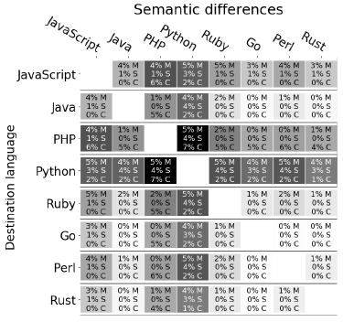
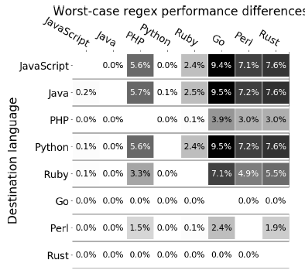


Summarized in heatmaps
Semantic differences
Performance differences
Notes:
We think a good way to visualize our experimental findings is through heatmaps illustrating the pairwise semantic and performance differences between languages,
The darker the cell, the riskier it is to move regexes from that source to that destination.
We hope these will benefit practitioners thinking about copy/pasting regexes.

Slide 120
Defeat Selective memoization

Slide 121

Avoiding REDOS when your PL has a Spencer engine
Approach | Example | Shortcomings
Refactor regex | Study #1 | Error-prone
3rd-party regex engine | Google’s RE2 | Backwards compatibility
Terminate long matches | PHP, Perl | Backwards compatibility
Change engine’s match algorithm | Thompson | Backwards compatibility Semantic changes?
Optimize engine’s match algorithm |  | Potentially more space Parameterized bound
No backwards compatibility issues
Some space cost
Parameterized linear/polynomial bound
Notes:
Talk through the options that application and programming language designers have to address REDOS issues.
First set: Application-level changes
Second set: Changes that also affect the engine

Slide 122
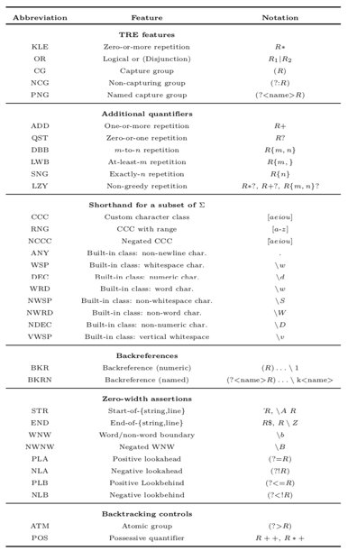
What are the available regex features? (PCRE2)
Notes:
There are loads of features.
We can categorize them by their complexity.

Slide 123
What time complexities are currently offered?
Spencer engine docs: “Could take a long time” (no bounds given)
Actual bounds based on Perl and PCRE engines
Category | Impl. approach | Time complexity
Most TRE features | Spencer | Exp-time
Lookaround assertions | Recursion | Poly-time or worse
Backreferences | Spencer | Exp-time

Slide 124
What regex features do practitioners need?
I measured the corpus of 530K regexes, and found that…
97% of regexes use only TRE features
2.96% use at least one look-around assertion
0.7% of regexes use at least one backreference
95% of these use 1 or 2 backreferences, most is 20
So to be backwards compatible, we can’t just drop support like RE2

Slide 125
The benefits of selective memoization
“aa…a!”
Linear time complexity
Reducing space complexity
Exponential time
Linear time
Node 1, offset 1
Too much space required
“a” (outer loop)
Number of steps
“a” (inner loop)
Selective memoization
Linear time 97% of regexes
Linear space 99% of regexes
Node 1, offset 2
Node 1, offset 2
Far less space,
same guarantee!
“a” (outer loop)
“a” (inner loop)
“a” (inner loop)
Typical space multipliers
Node 1, offset 3
Node 1, offset 3
…
…
Selected set of NFA vertices
Notes:
Earlier I explained how regex engines work.
They employ a backtracking search,
and explore every potentially-feasible path through the automaton.
* Let's take our old automaton as an example.
While matching "aa!", we'll see simulation paths like these:
* We start at node 1 (the node marked "a"), at string offset 1
* When we see an "a", we have a choice of the inner or the outer loop
* Let's favor the inner loop, so we'll move to node 1, offset 2, and try the other path later
* We'll keep doing this and eventually mismatch
* Then we'll backtrack -- let's suppose we try the other choice back at the beginning
Now we're at Node 1, offset 2 again.
* From there, we can get to node 1, offset 3 again, and so on
You can see that we're retracing our steps along different paths.
The NFA simulation is visiting the same vertices at the same offsets over and over again.
But about 97% of regex matches are path-independent,
so all of these paths on the right side are redundant.
A natural solution to avoid redundant paths is a technique called memoization.
Essentially, memoization introduces bread crumbs into the NFA simulation,
and if the simulation encounters a bread crumb then it knows that that path didn’t work.
During the simulation, we can mark the node-offset pairs as we visit them, like so
*
*
Then when we backtrack, we can see the redundancy and short-circuit those paths.
I've implemented a prototype regex engine to illustrate this approach.
* This chart shows the number of steps in the NFA simulation for this exponential regex.
The blue line is the current behavior of most regex engines.
The orange line is the behavior of our prototype.
* As expected, memoization changes the worst-case behavior
* from exponential to linear growth
This approach offers a great improvement in time complexity.
But what about space costs?
Regexes can be pretty large, so memoizing every state can take a lot of space.
* Let's put aside time complexity for now,
and apply our regex corpus to take a look at space complexity
Our current memoization scheme requires making as many copies of the input string as there are NFA vertices.
* This chart shows the distribution of NFA sizes for the regexes from our corpus.
* If we memoize all vertices, we’ll need 20 to 40 copies of the input string for typical regexes.
In some cases this might be acceptable.
But if input strings can be long, this space cost may be too much for practical purposes.
* Fortunately, I have shown that we can memoize a selected subset of the vertices
* and obtain the same time guarantee – I have omitted the proof
For 99% of real-world regexes, this subset is consistently quite small
* Let’s sum up:
* Using selective memoization, for most regexes
* regex engines can offer linear time complexity
* at the cost of only a few copies of the input string
We think this is a promising solution!
We are investigating the engineering costs of incorporating it into production-grade backtracking regex engines.
TRANSITION
XXX
=====
This is a 5-minute slide.

